Slide 1
In the comfort zone
Working in remote Australia
Sasha Houthuysen and Dameyon Bonson

Slide 2
Warburton (Milyirrtjarra)
Located in the Ngaanyatjarra Lands, Gibson Desert, Western Australia.
1,050kms south west of Alice Springs and 750kms north east of Kalgoorlie, on the Great Central Road (Outback Way).

Slide 3
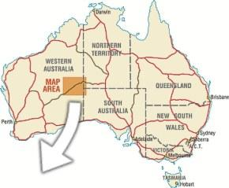

Slide 4
Benefits of no pre concieved ideas
We all know the Aboriginal stats….
Over crowding
Poor health rates
Lower life expectancy
Low employment rates
High incarceration rates etc…
These can overpower the work sometimes and can create to big a goal to fix
Small community minded steps…

Slide 5
Empowerment
Empowerment model is about increasing, emphasising, developing and nurturing strengths and positive attributes.
Aims at enhancing individuals, groups, families and communities power and control over their destinies.
The strengths perspective also sits hand in hand with this model.

Slide 6
Community Development
Community Development focuses on the principle that within any community there is a wealth of knowledge and experience that can be channelled into collective action to achieve the communities' desired goals.
Working ‘with’ a community, not ‘on’ a community
Basically the community are the experts in solving their issues…

Slide 7
What it looked like in Warburton
Working Malpara ways (malpa is Ngaanyatjarra for friend)
Consultations with the right community people
Consultations in language
Consultations out bush
Implementation in partnership

Slide 8
Understanding of Mental Helath
Traditional, holistic and spiritual sense of mental health.
Defining sickness or sadness as mental health issues.
Establishment of an early intervention program that focuses on activities to promote positive health and wellbeing.
Respite from everyday life

Slide 9
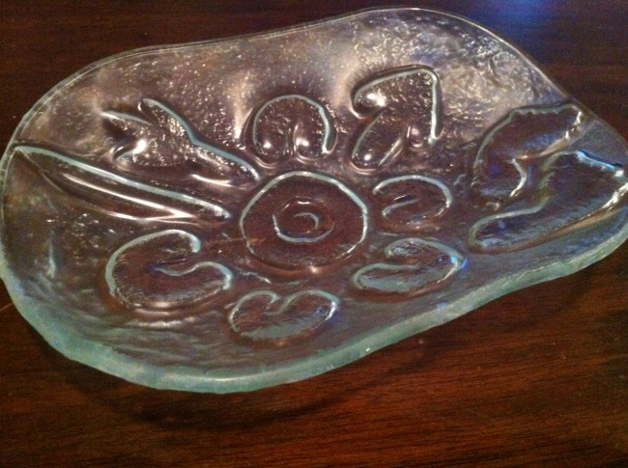
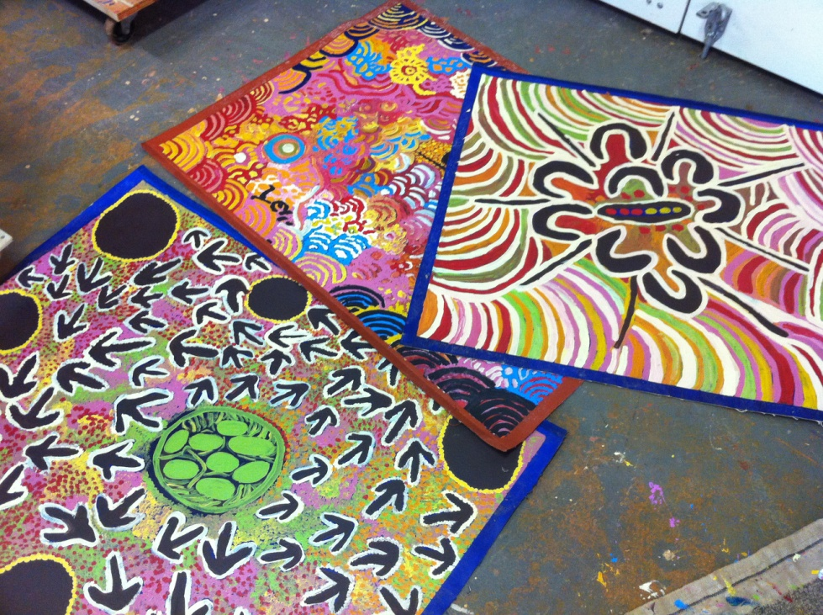
Program up and running - Arts

Slide 10
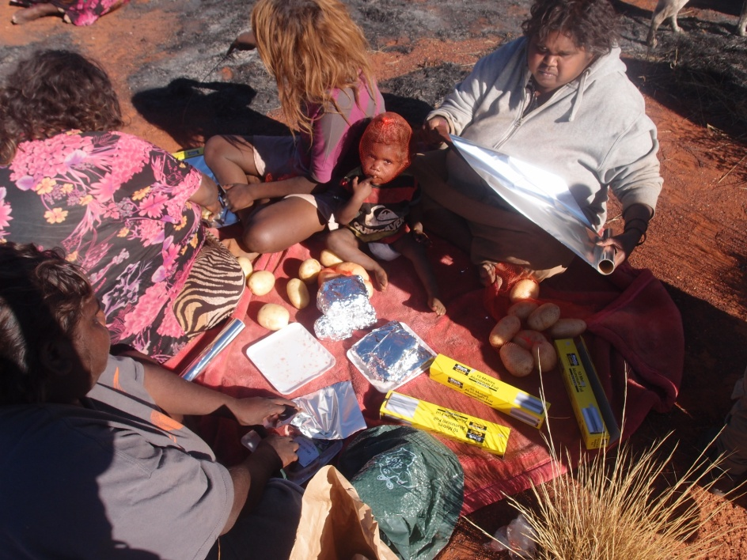
Program up and running - Cooking

Slide 11
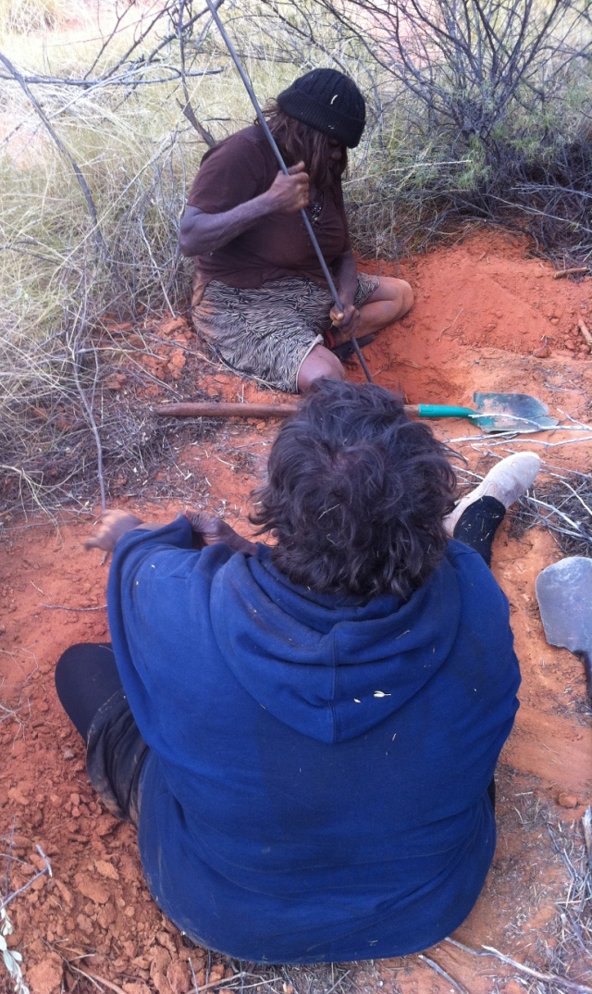
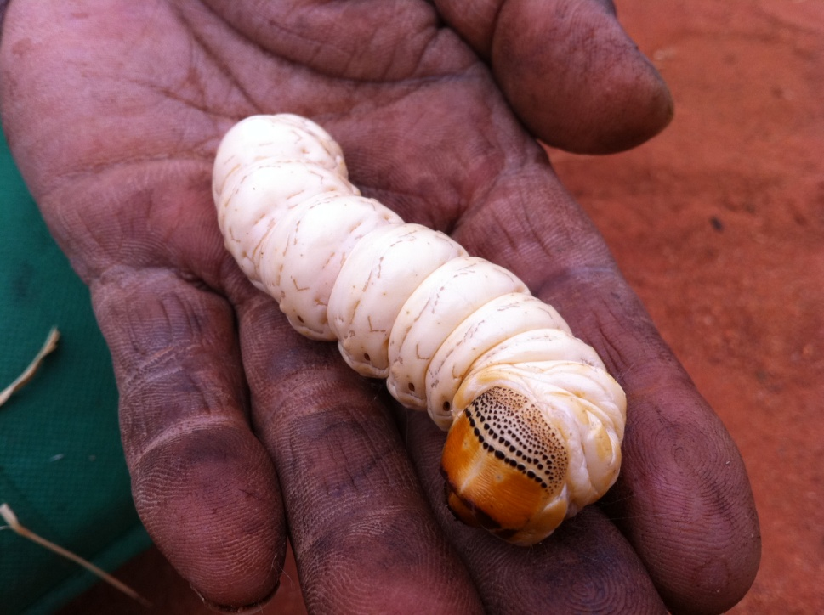
Program up and running - Gathering

Slide 12
Existing resources
Using established and thriving programs to assist you in service delivery
Tapping into other agencies for information sharing

Slide 13
Professional Boundaries
Workers role is not to ‘fix’
Social work is more than just helping
Would it be done in an urban setting?? If not why do it in a remote…

Slide 14
Summary
Relationships
Empowerment
Community Development
Consultation and active implementation
Professional boundaries

Slide 15
Personal Experiences - Dameyon Bonson 2012
Social Work Education
Indigenous Men SEWB - Strengthening the Warrior within

Slide 16
Social Work Education
Over a 4 year period there are 48 assessed pieces required
Only 2 of those pieces required you to apply your social work learning to Indigenous Australians

Slide 17
Social Work Education and Whiteness
Social work teaches you how to be an monoculture/caucasian practitioner.
Social work teaches white Australians how to look after its own and ‘help’ others

Slide 18
Lila Watson
If you have come here to help me, you are wasting your time. But if you have come because your liberation is bound up with mine, then let us work together.

Slide 19
Indigenous Men SEWB - Strengthening the Warrior within
‘Social and emotional wellbeing problems’ have been described by Aboriginal people as ‘a broad range of problems that can result from unresolved grief and loss, trauma and abuse, domestic violence, removal from family, substance misuse, family breakdown, cultural dislocation, racism and discrimination, and social disadvantage’ (Social Health Reference Group,
2004, p.9).

Slide 20
Indigenous Men SEWB - Strengthening the Warrior within
Despite what the literature says, Indigenous men want to take greater responsibility themselves. To improve their status in their own health and play their rightful role as leaders, fathers, uncles, husbands and grandfathers; yet rarely are they provided the space to do so (Bonson 2012).

Slide 21
Indigenous Men SEWB - Strengthening the Warrior within
The Strengthening the Warrior within program is being developed to work towards alleviating the mitigating factors of suicide for Indigenous men; their social and emotional well being and understaning violent behaviours in their community.

Slide 22
Indigenous Men SEWB - Strengthening the Warrior within
Indigenous men are resourceful despite arbitrary restriction. (Bonson 2012).

Slide 23
Indigenous Men SEWB - Strengthening the Warrior within
Colonisation - The experience of being colonised involves loss—of culture, language, land, resources, political autonomy, religious freedom and, often, personal autonomy. These losses may have a direct relationship to the poor health, social and economic status of Aboriginal people. (Archibold 2006)

Slide 24
Indigenous Men SEWB - Strengthening the Warrior within
Decolonisation - The experience of being decolonised involves living with unobstructed access to your culture, language, land, resources. To political autonomy, religious freedom and personal autonomy. This reconnection has a direct relationship to the positive social and emotional wellbeing of Indigenous men in the Kimberley. (Bonson 2012)

Slide 25
Oppressive language - Toni Morrison
‘Oppressive language does more than represent violence; it is violence; does more than represents the limits knowledge it limits knowledge.’

Slide 26
Recommendations
Our voices : Aboriginal and Torres Strait Islander social work (2013) Bindi Bennett, Sue Green, Stephanie Gilbert, Dawn Bessarab South Yarra, Vic. : Palgrave Macmillan
Twitter follow @IndigenousX and the #IndigenousX hashtag

