Slide 1
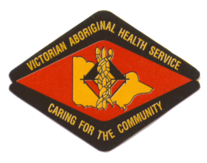
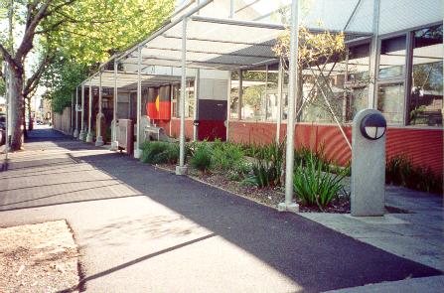
Victorian Aboriginal Health Service (VAHS) 186 Nicholson st Fitzroy

Slide 2
We would like to acknowledge & pay respect to the traditional owners, Elders Past and Present of the land on which we meet today

Slide 3
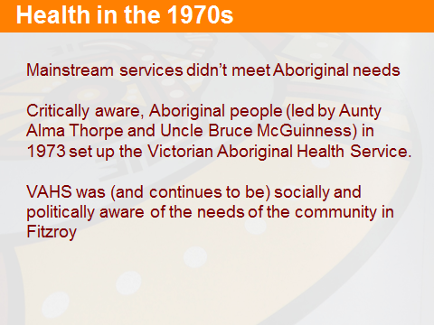

Slide 4
VAHS: The early years
“ at the very beginnings of the history …for one year …the volunteers kept open that place. The very first health service. So it was all voluntary, no one was being paid.”(VAHS community member 2010).

Slide 5
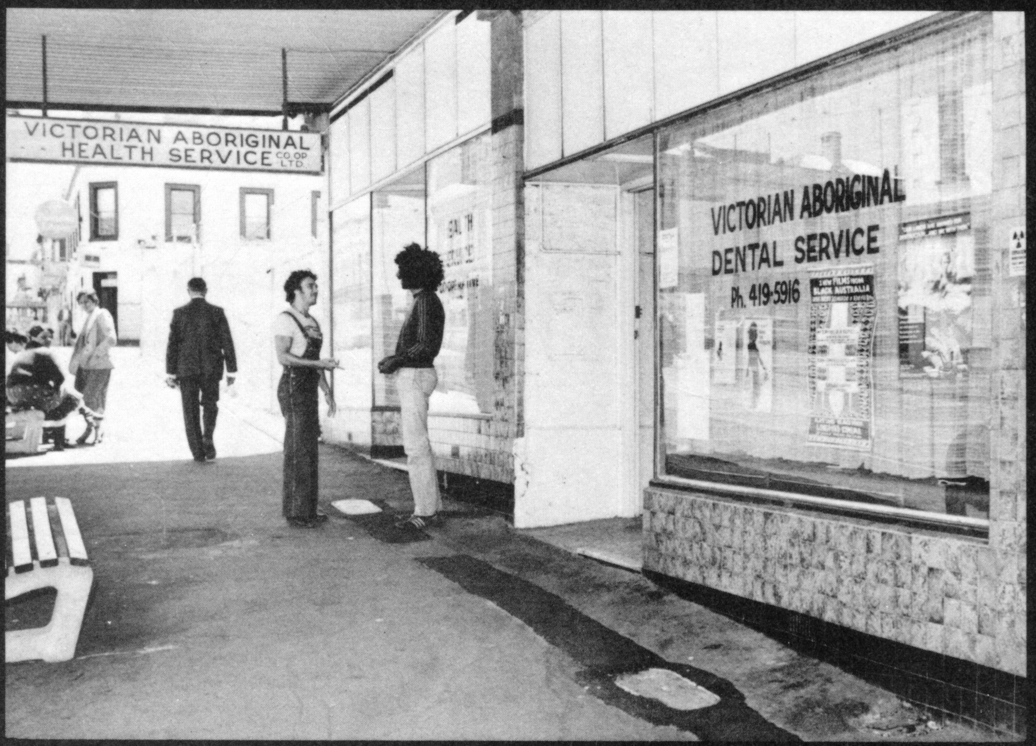
Founded in 1973 by members of the Aboriginal community and concerned doctors
Established in 1973-Gertrude St, Fitzroy.
Notes:
Since it was established in 1973, VAHS has grown from a shop front service providing basic treatment to a one-stop-shop providing a wide range of health-care services, health promotion and contributing broadly to wider health related organisations and research

Slide 6
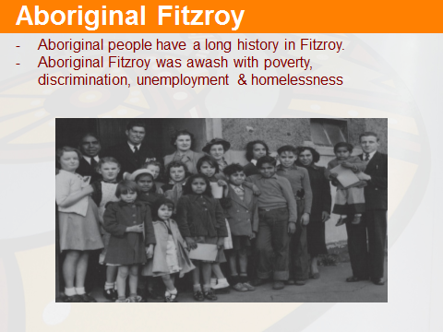

Slide 7
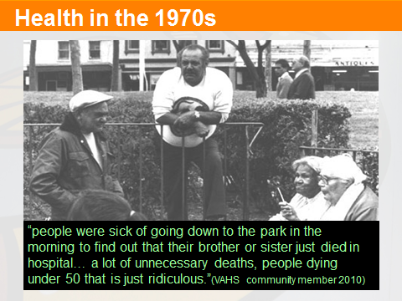

Slide 8
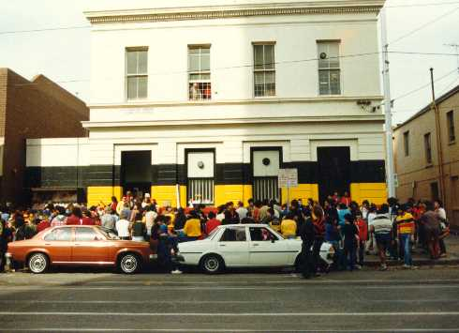
136 Gertrude st, Fitzroy
In 1979 the Health Service moved to the old government clinic in Gertrude street with support from a small amount of government funding

Slide 9
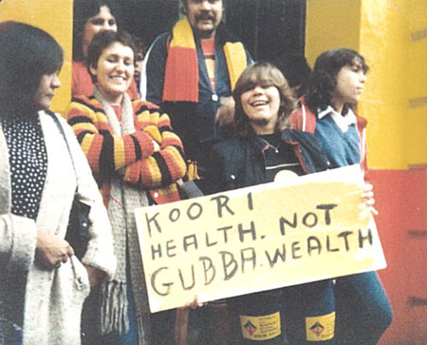
Rights based approach
“I can remember early days, the focus was on, health was seen as a right…We had the right to good health and we had the right to run our own health business, and we should never loose that focus.”
(Community Member 2010)

Slide 10
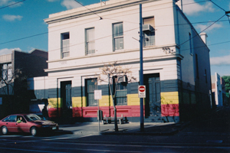
A Home Away from Home
“a home away from home’…people would come down from country areas, and that would be the first place they would go to, as a meeting place”(VAHS community member 2010)

Slide 11
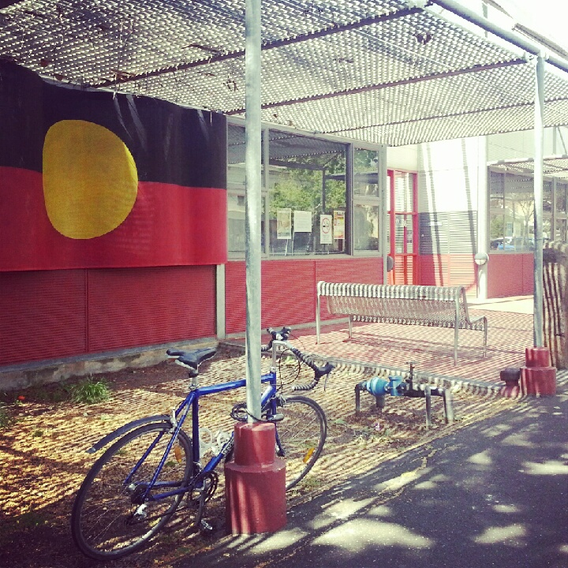
The Victorian Aboriginal Health Service
Victorian Aboriginal Health Service is a registered Co-operative.
Controlled by a board of seven Aboriginal Directors elected
at an Annual General Meeting- By Our Community.
Membership is open to Aboriginal people over the age of eighteen years.

Slide 12
Victorian Aboriginal Health Service: ‘One stop shop’ ACCREDITED GENERAL PRACTICE
Healthy Lifestyle Team
Mens Health Unit
Manager
Alan Brown
Outreach
Case Management
Service Delivery
Holistic Care
Transport
Community Health Services
Advocacy
service provided
extension of care plan
Hospitals and Specialists
shared care
VAHS One-stop-shop
Care Coordination
Eg: Group booking for clinics Breast screen
Family Counselling
Manager
Helen Kennedy
ADULT MENTAL HEALTH
ADOLESCENT MENTAL HEALTH
KOORI KIDS MENTAL HEALTH
DRUG & ALCOHOL WORKER
CARER SUPPORT
SMITH STREET OUTREACH
FINANCIAL WELLBEING PROGRAM
Clinical Programs Practice Manager
Andrew Baker
MEDICAL
SPECIALISTS
TRANSPORT
REFERRAL
STD / HIR NURSE
GP’S
ABORIGINAL HEALTH WORKERS
“HEALTHY 4 LIFE” AHW
PHARMACY
ALLIED HEALTH
OPTOMETRY
DIV. 1 NURSE
MEDICAL DIRECTOR
DIABETES EDUCATOR
Management
CEO
Glenda Thorpe
Oral Health
Manager
Christine Ingram
Women & Children’s Unit
Manager
Susan Hedges
Community Programs
Manager
Denise McGuinness
ALTERNATIVE BIRTHING
“HEALTHY 4 LIFE” AHW
HEALTH EAR PROGRAM
WELL WOMAN’S CLINIC
BOORAI CLASSES
ADMIN/RECEPTION
HR
FINANCE
CORPARTE SERVICES
AHPACC
IT&T
POLICY
HACC
ALLIED HEALTH
INTAKE WORKER
ACTIVE ELDERS PROGRAMS
NURSING
ABORIGINAL HEALTH WORKERS
DENTIST
DENTAL NURSES
DENTAL THERAPIST
DENTAL HEALTH WORKER

Slide 13
VAHS Healthcare Profile
65,000 Client contacts per year
10,000 Active clinical files
30,000 Dental files, representing 75% of the Victorian Aboriginal Community.
Aboriginal Health Workers and staff are an intimate part of every aspect of VAHS work.
VAHS offers a range of specialist services with expertise in Chronic Disease
Notes:
35 thousand aboriginal people living in victoria, according to lastest cencus data

Slide 14
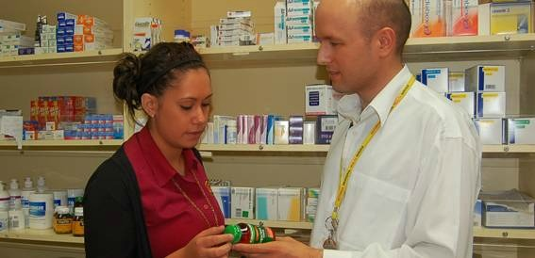
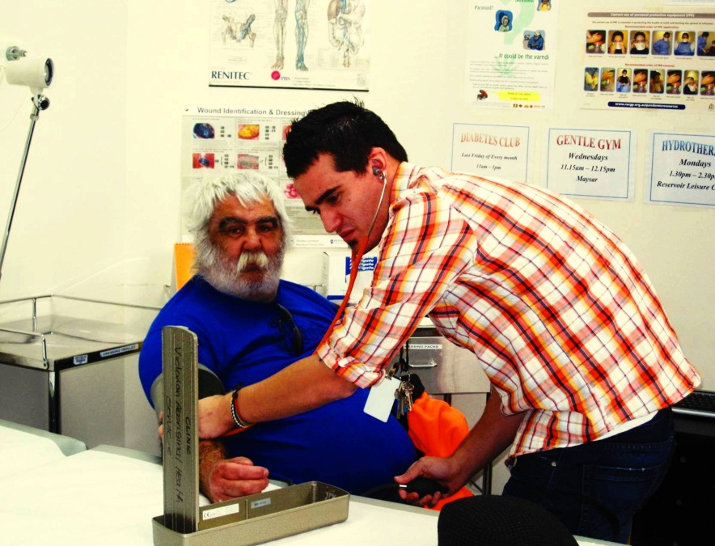
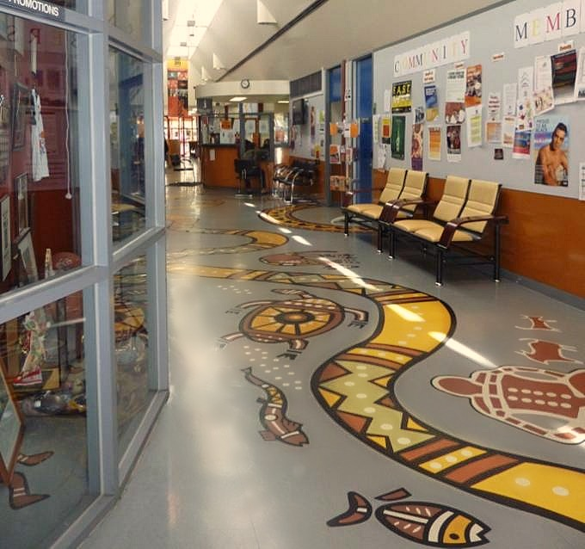
MEDICAL

Slide 15
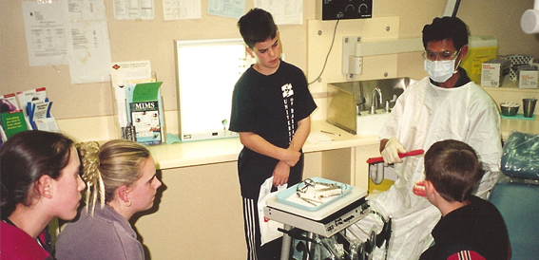
DENTAL

Slide 16
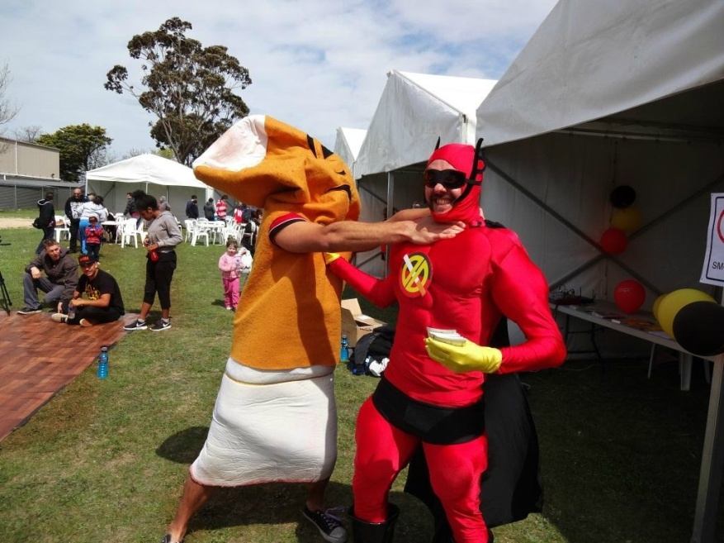
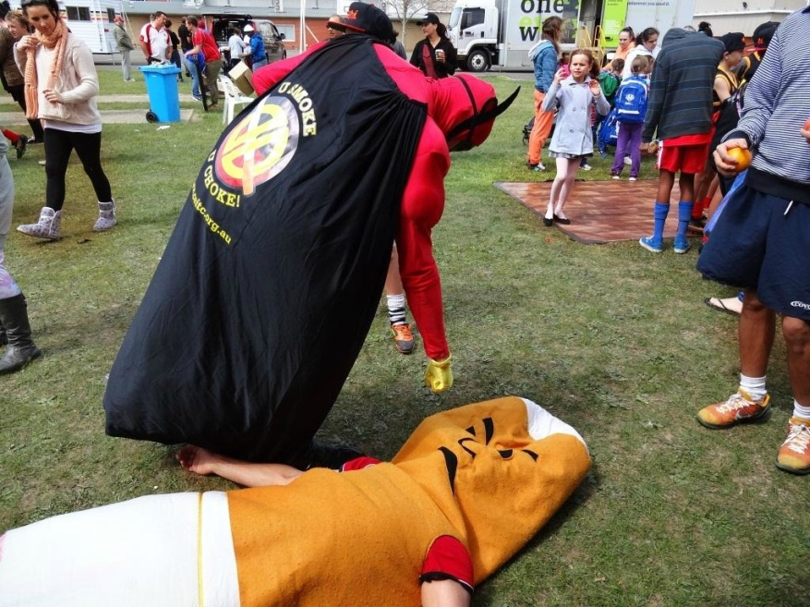
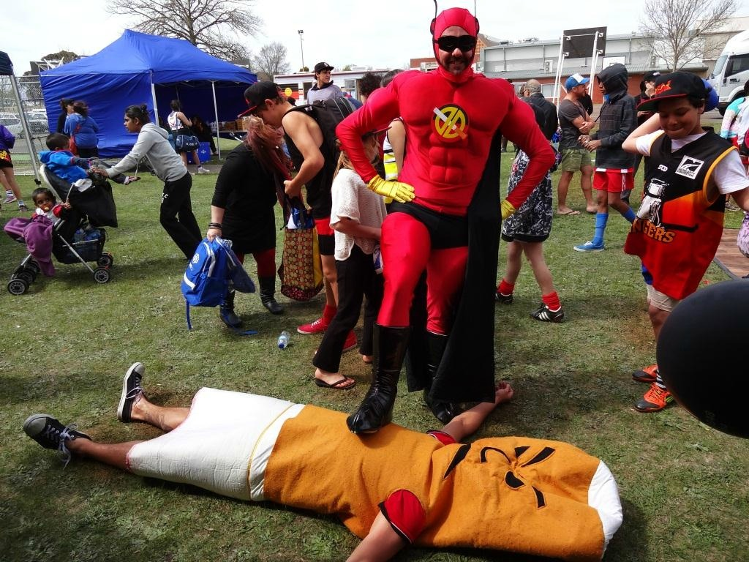
Healthy Lifestyle Team

Slide 17
Community Programs
Home and Community Care (HACC)
State Funded by The Department of Human Services
Our Services
Intake and Assessment.
Doctor
Physiotherapy
Occupational Therapy
Dietitian
Nursing
Podiatry
Active Lifestyle Programs
Well For Life Forums
All services available for outreach and In Home Support
Notes:
Home and Community Care (HACC)
The HACC Program along with the Active Service Model (ASM) approach is intended to provide support services to meet the needs of individuals so they can remain at home longer rather than going into residential care.
VAHS HACC services are for Elders, and adults living with chronic diseases (such as diabetes or arthritis) or have a disability.
There is an assessment process which happens before a HACC service can be arranged. Community members are encouraged to call the VAHS to make an appointment for an assessment.

Slide 18
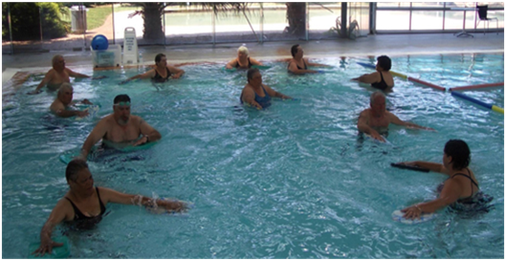
Hydrotherapy

Slide 19
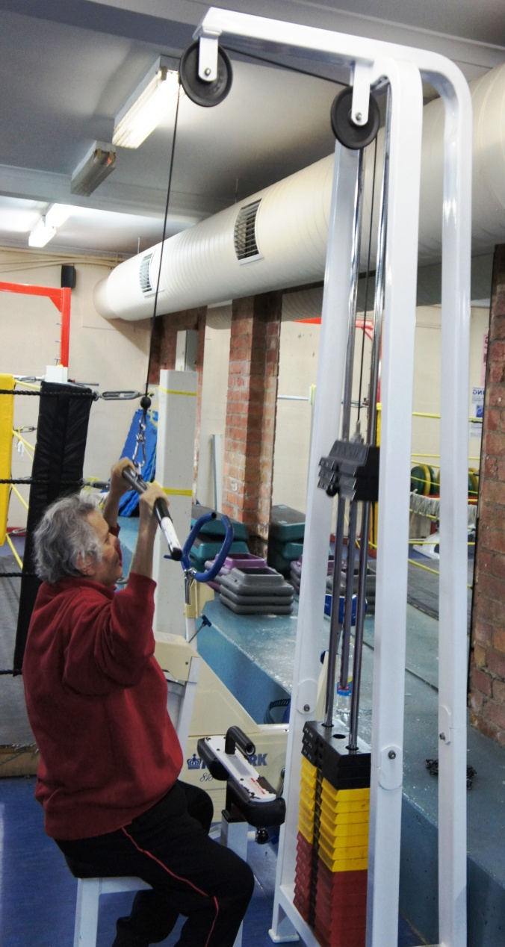
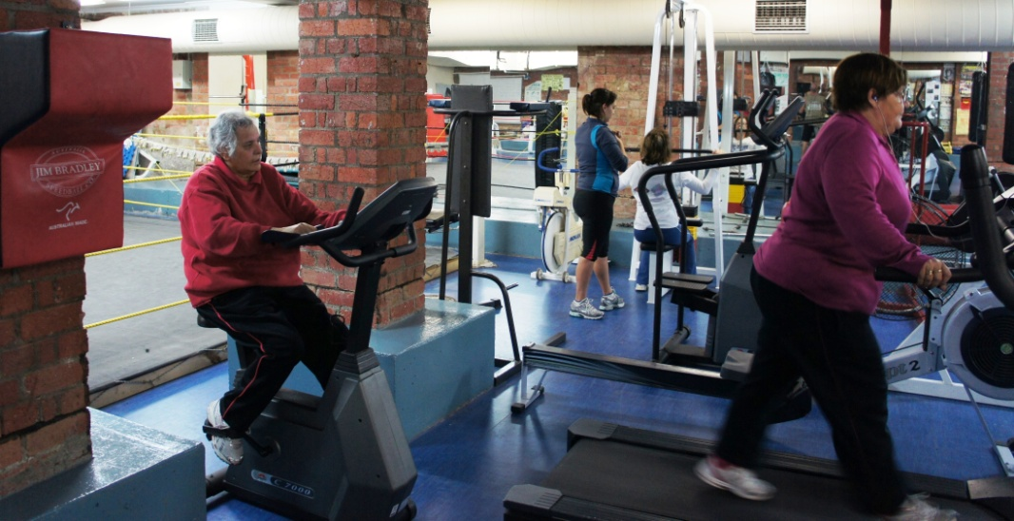
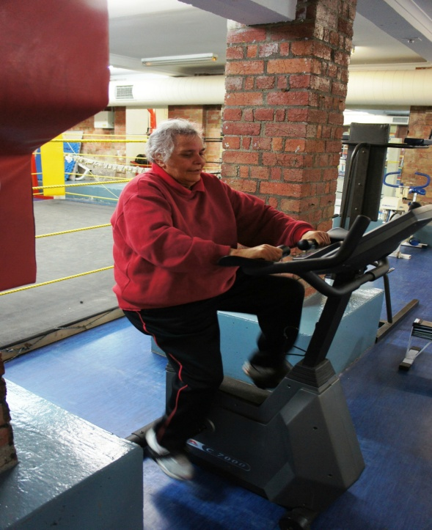
Gentle Gym

Slide 20
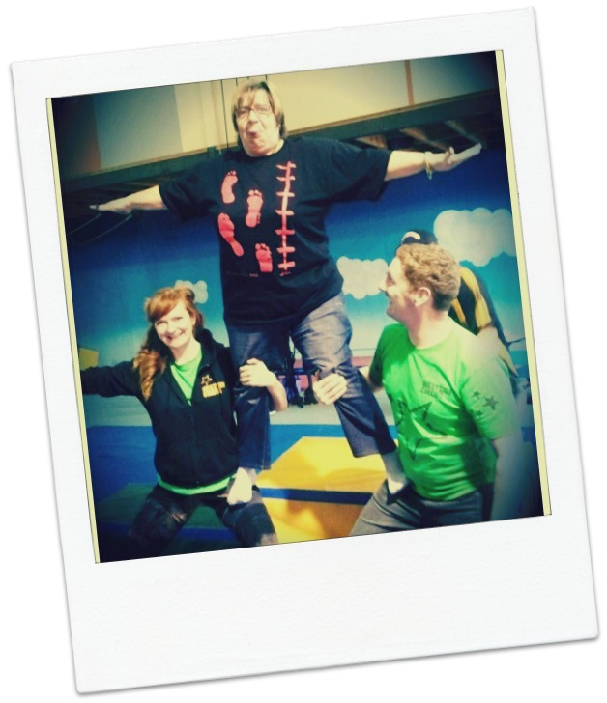
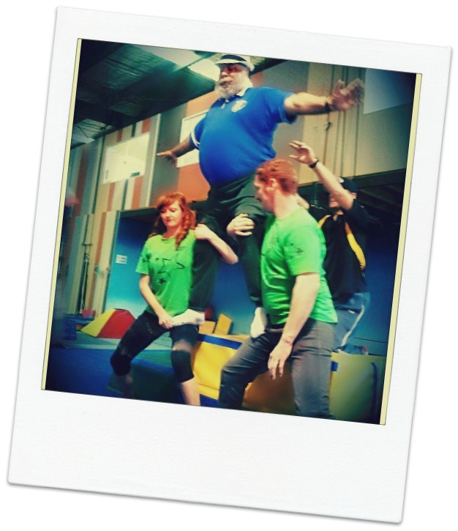
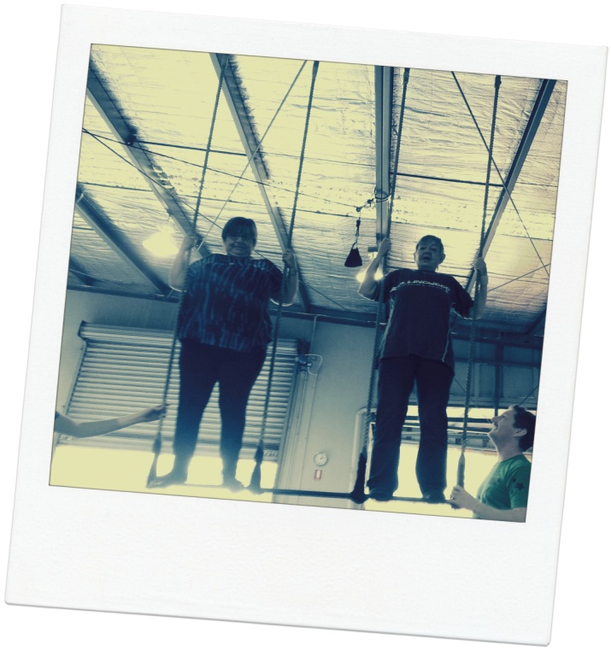
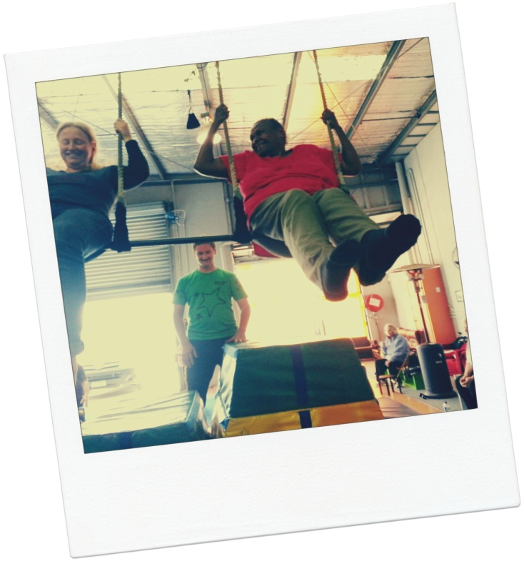
Circus

Slide 21
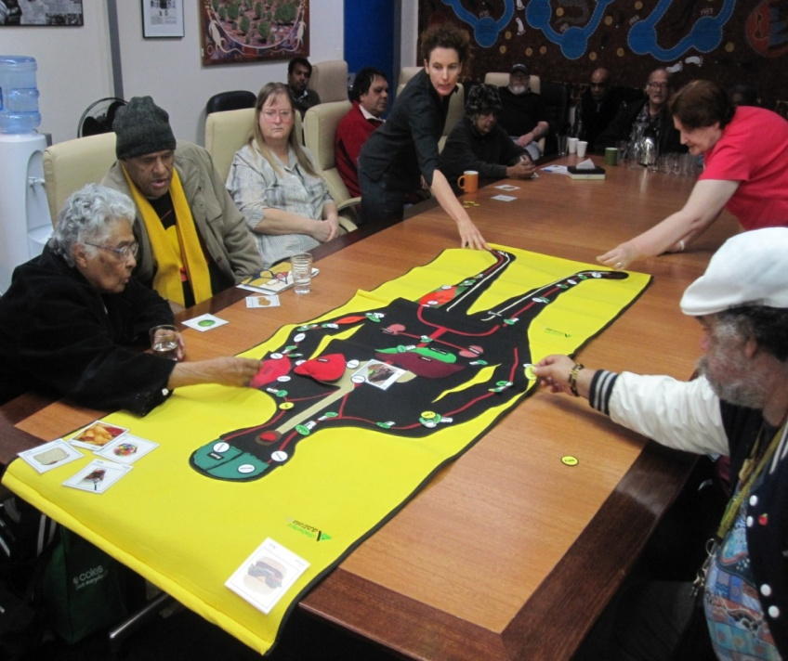
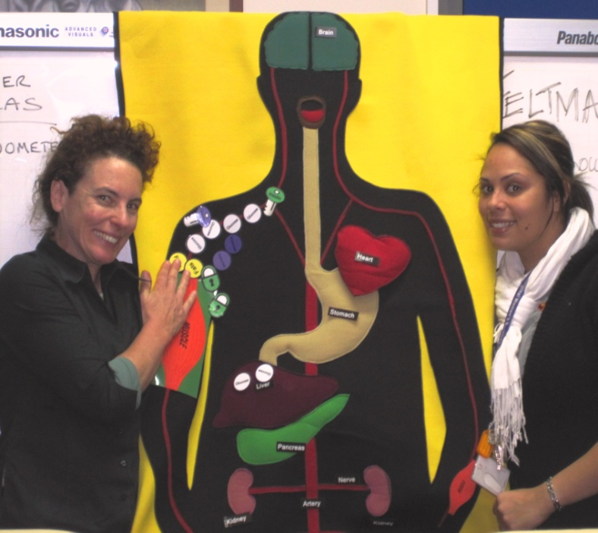
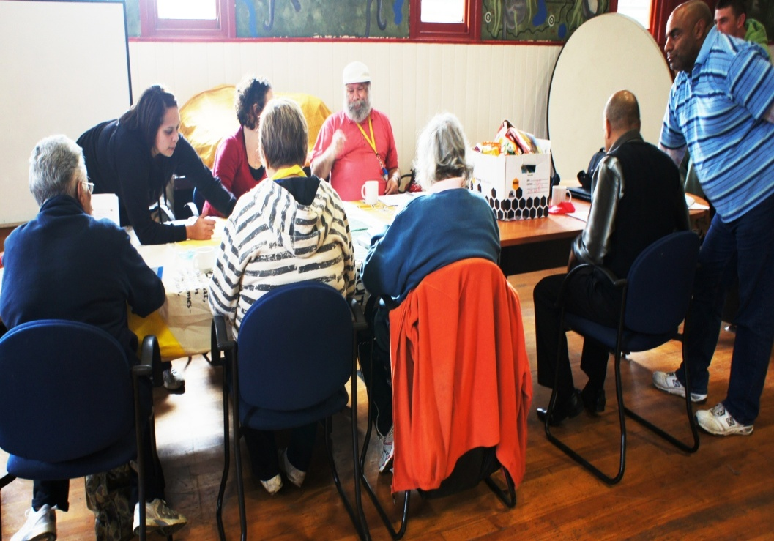
Diabetes Club

Slide 22

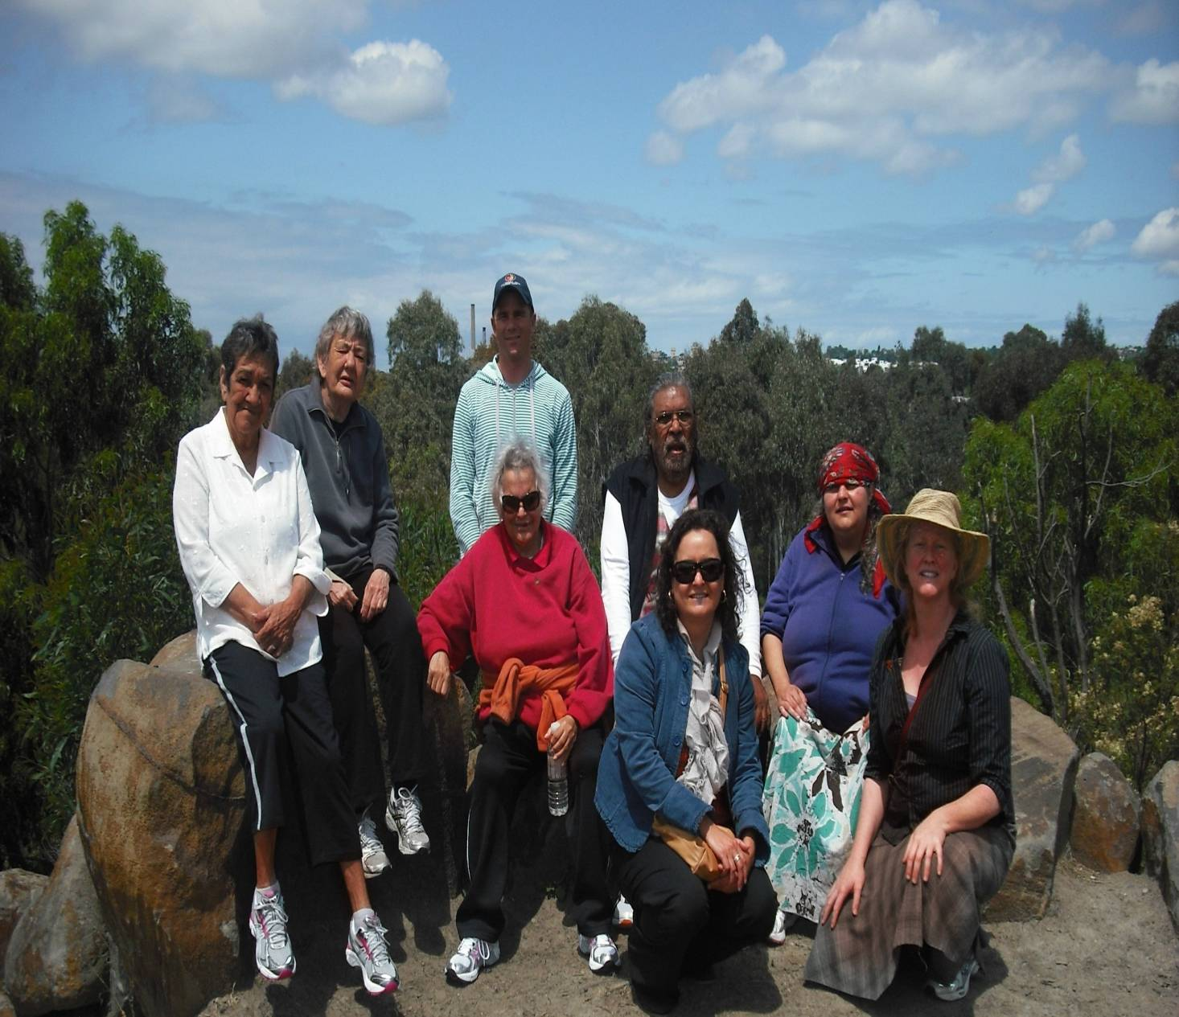
MAKE A MOVE
15 week
Falls and balance prevention program

Slide 23
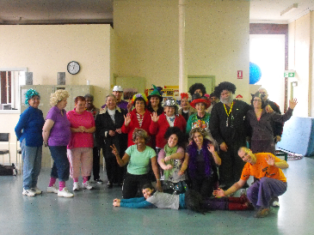
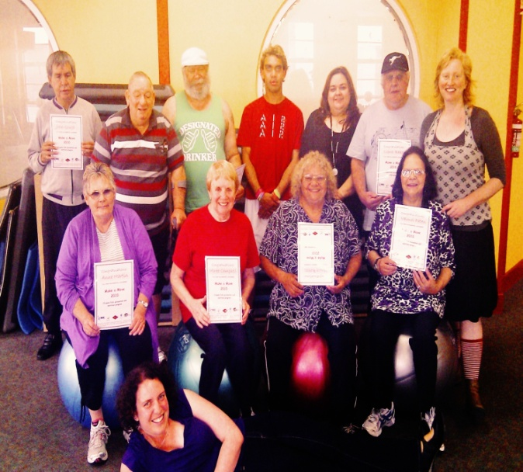
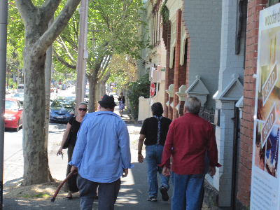
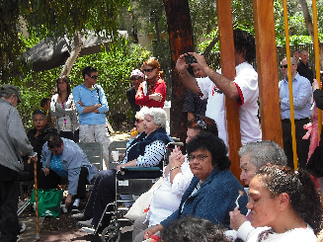
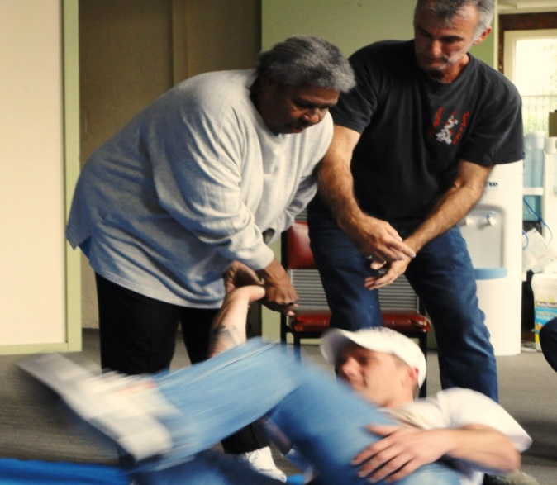
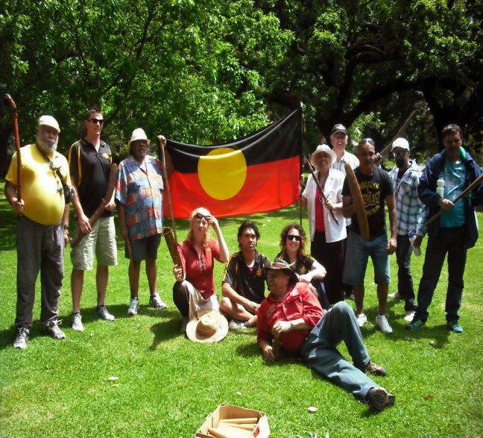
Other Activities….
Elders Circus –
Make a Move
Walks
Community Event
Self Defence
Cultural Walk-

Slide 24
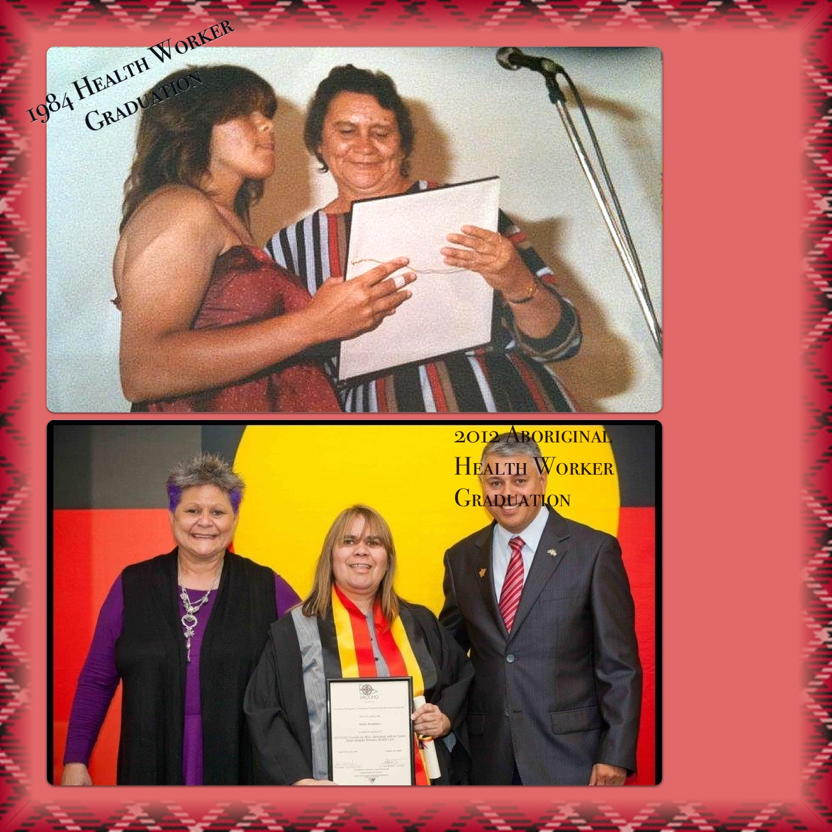

Slide 25
