Slide 1
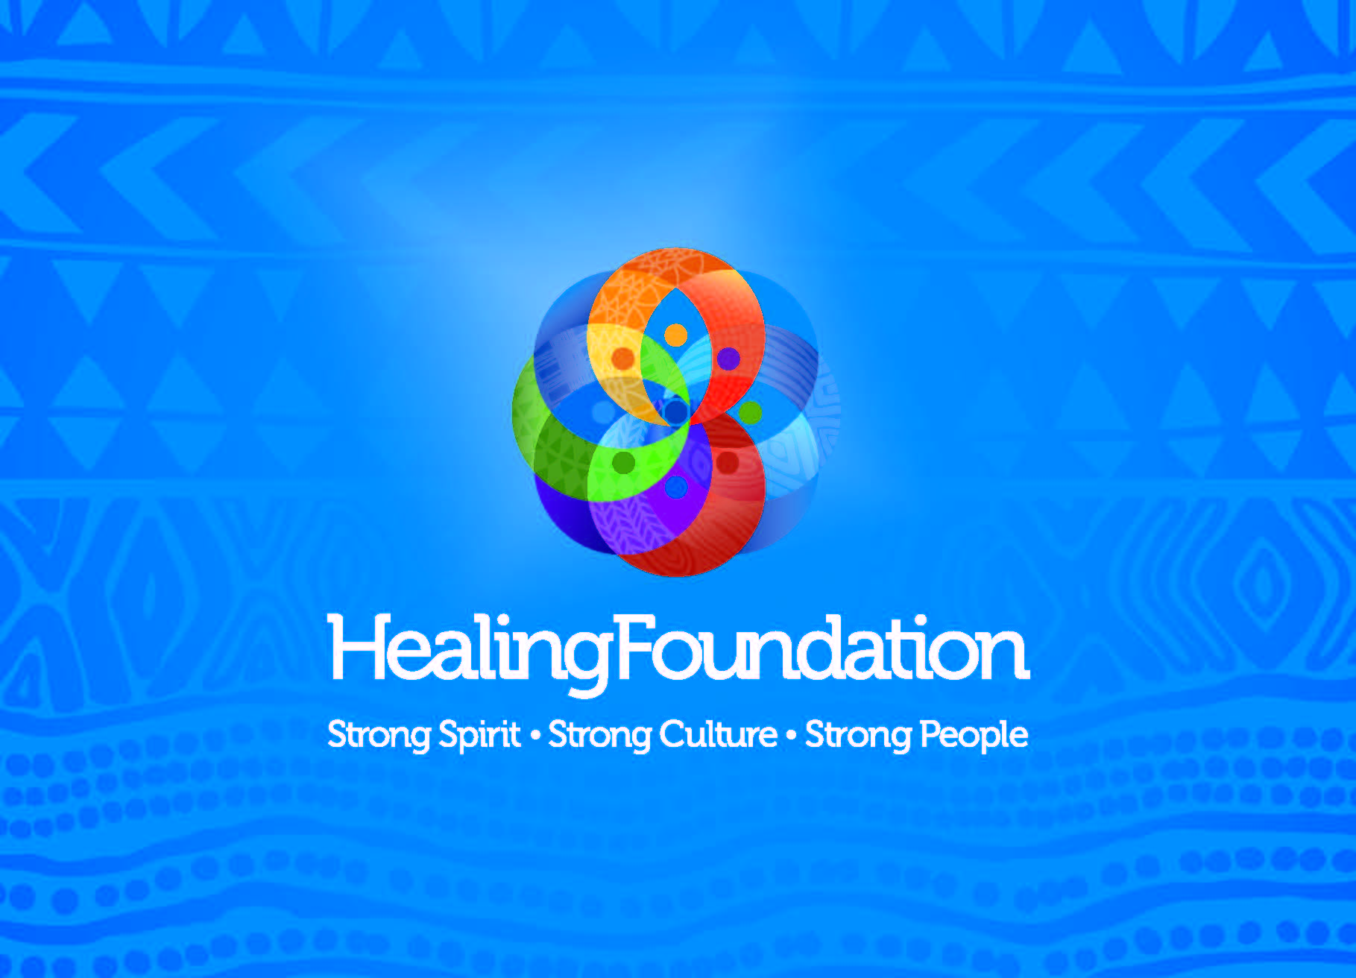

Slide 2
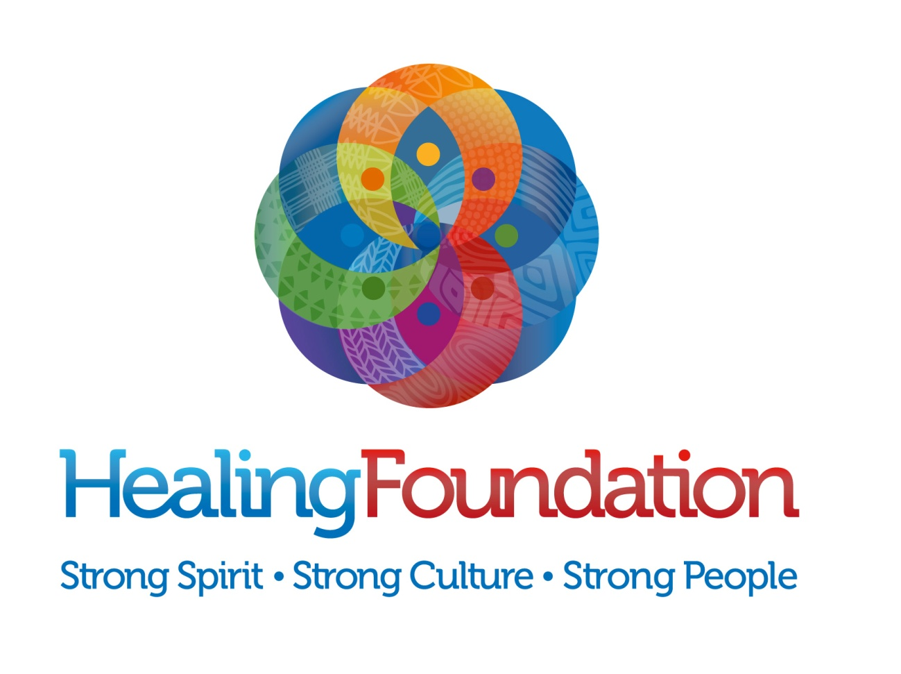
Who Are We
The Aboriginal and Torres Strait Islander
Healing Foundation is an independent Indigenous organisation with a focus on healing our community.

Slide 3
Where We Came from
13 February 2009
May – August 2009
30 October 2009
Healing Foundation incorporated.
National consultation “Voices from the Campfire”.
Federal Government (FaHCSIA) announces funding for Healing Foundation over 4 years.

Slide 4
What is Healing?
A process of returning to our physical, emotional, spiritual and cultural wellbeing.
Recovering from an intergenerational cycle of trauma, caused from the legacy of colonisation, forced removals and other past government policies
Recovery from psychological trauma of cultural and social disconnection/marginalisation.
Occurs over the long term.
Healing is a journey.

Slide 5
What we do
Support the development of culturally strong, community develop programs, locally run programs for Indigenous people in the community.
Develop the story of healing.
Build capacity and leadership within communities.
Fund community based training and education projects.
Research best practice in culturally strong healing programs.
Undertake evaluation of our projects.

Slide 6
Achievements to date
The Healing Foundation has funded across Australia:
21
Healing projects
48
Training & Education projects
3
Intergenerational Trauma projects

Slide 7
Outcomes
21 first round funded projects up to December 2011.
162 Aboriginal and Torres Strait Islander people employed across 18 projects.
3622 people participating in healing including children, young people, families, men, women, stolen generations members and Elders.
560 cultural activities provided.

Slide 8
Improving mental health
Preventing suicide
Strengthening Social & Emotional wellbeing workforce
Building Indigenous owned & controlled NGO’s to tackle SEWB
A national Indigenous mental
health strategy
Further investment in Healing

Slide 9
Healing Foundation initiatives
Feasibility on Healing Centres
Feasibility on a training and education ‘Institute’
Supporting the retention of traditional healing.

Slide 10
Are we Closing the Gap?
Closing the Gap
Education
Employment
Health
Psychological trauma
Social disconnection
Intergenerational trauma
Family & community dysfunction

Slide 11
CLOSING THE GAP and HEALING
Closing the Gap
The Healing Foundation is Closing the Gap by providing the foundation to deal with factors stopping our people exceling in 3 of the building blocks of a healthy life.
We assist Aboriginal and Torres Strait Islander people to fully participate in their lives including education, employment, parenting, cultural life and health and wellbeing.
Education
Employment
Health
Healing

Slide 12
Early Indicators
In the last 6 month period, from just 19 programs:
164 Aboriginal and Torres Strait Islander people have been employed.
3,637 children, young people, Stolen Generations members, Elders, men and women have received a service
96% of participants improved social emotional spiritual and physical wellbeing.
70 % have provided support to parents to support better parenting.
323 health and wellbeing activities have been provided nationally
5 projects direct links with schools and education children
2 supported adults reengaging in education and
training

