Slide 1

Indigenous Allied Health Australia “Joining the Dots” Conference Brisbane November 2012
Silent Questions…………
Presented by Jody Saxton-Barney
Deaf Indigenous Community Consultancy

Slide 2


Acknowledgement to Country…
Traditional Owners
Elders
All Aboriginal and Torres Strait Islanders attending today

Slide 3
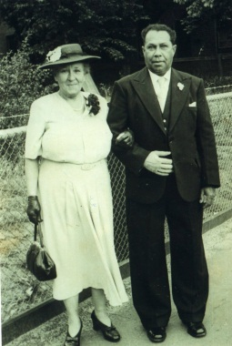
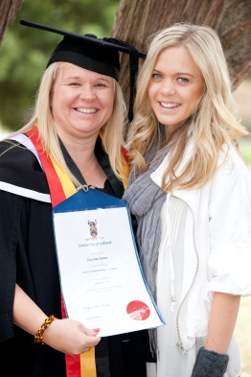
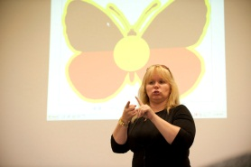

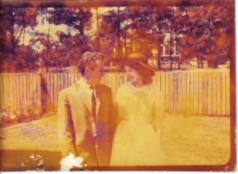
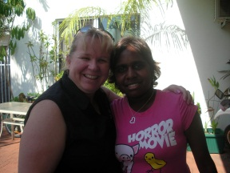
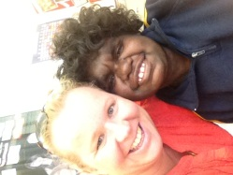
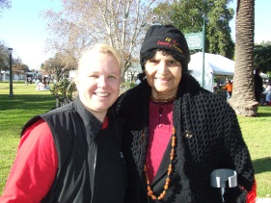
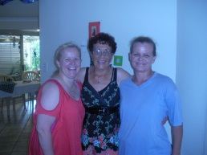
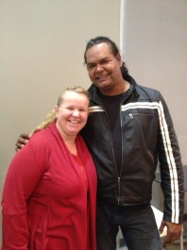
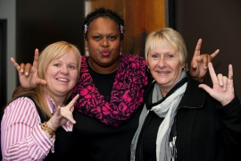
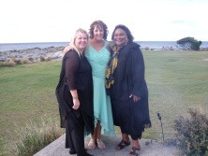
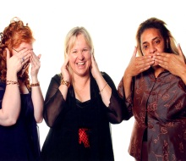
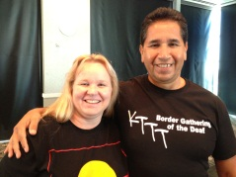
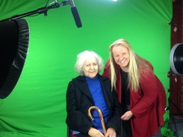
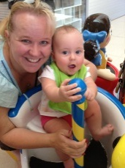
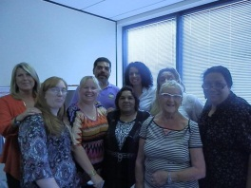
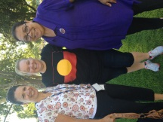
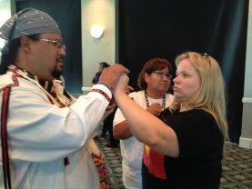
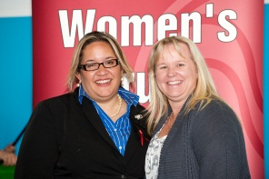
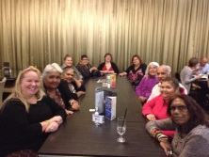
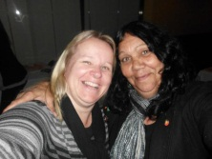
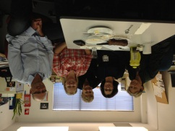
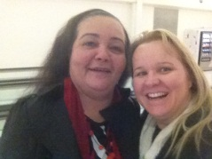
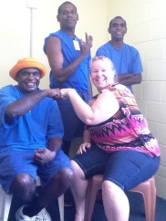
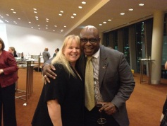
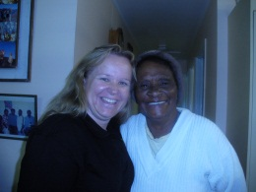
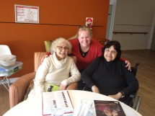
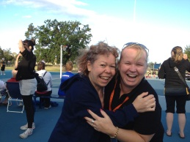
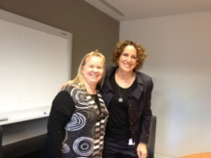
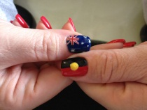
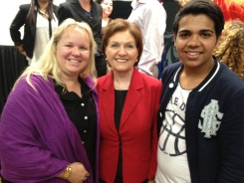
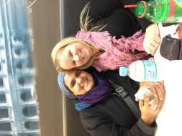
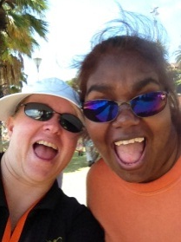
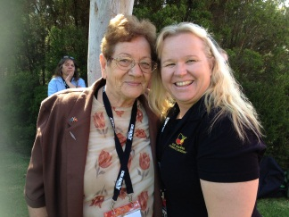
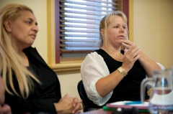
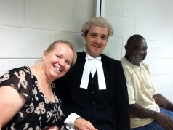
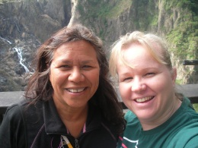
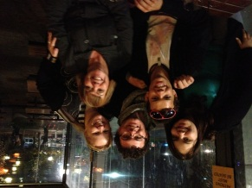
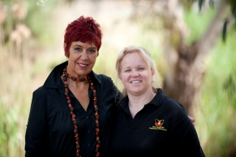
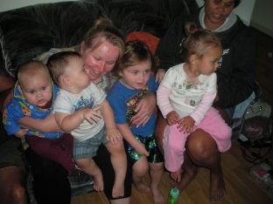
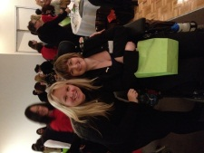
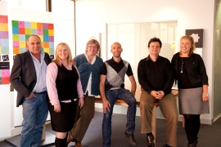
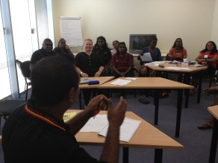
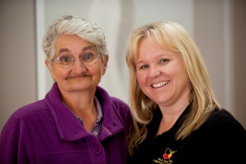
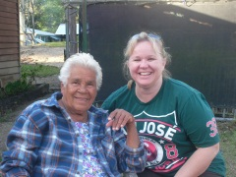
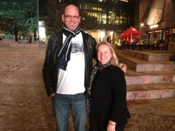
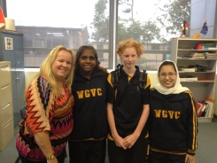
……who am I….

Slide 4
Cultural Brokerage
Cultural brokerage: is the process required to shift awareness into safe practice. It involves two-way communication where equal attention and respect of both cultures is applied. It is a shared communication experience where each party learns something of the other; where values and ideas are not pressed, but considerations from both sides are equally regarded
Cultural brokerage requires a subtle shift in the clinician / client dynamic, where deeper listening and sharing of ‘self’ reduces power differentials and builds trust
ms.cucrh.uwa.edu.au (retrieved 11/11/2012)

Slide 5

United Nations Declaration on the Rights of Indigenous Peoples
Affirming
that Indigenous peoples are equal to all other peoples,
while recognizing the right of all peoples to be different, to consider
themselves different, and to be respected as such,
http://www.un.org/esa/socdev/unpfii/documents/DRIPS_en.pdf (retrieved 19/11/12)
Notes:
So why am I here today, firstly I must say that to present here today is an honour, its not easy trying to include a social model of communication into a health/medical model of service delivery. Whilst most of us here do our work 24/7 in communities at times, we are often reverting to our own knowledge or connecting with a majority we trust and know “will get the job done”. We also look at establishing our relationships between service partnerships and community with little awareness of the underlining rights of clients with disabilities and who are deaf. So.. I wanted to start off with using this slide to show the various Rights based frameworks and bring your awareness to these statements for future discussion, implementation and passing them onto your workplace, communities and advocates to support clients into better Allied health services.
It starts with the Rights of Indigenous people. Many would ask me what I relate to being Deaf ( culture) or Aboriginal ( Indigenous)? The answer is simple to me, my culture as an Aboriginal woman is vital to my nurturing of my communication access to community and families. Therefore is the essential to ensure clients feel, are appreciated are able to understand their cultural rights.
It is also essential that we look at the way in which we engage with our partners, our service directors and our non-indigenous counterparts. This is to ensure that regardless if we are “black as the Ace of Spades” or “ White with blue eyes and red hair” we are who we say we are. Our mental health and well-being depends on it.
So to be accepted and acknowledged as an Aboriginal or Torres Strait Islander person is essential in addressing the first step of closing the gap…”Belonging”

Slide 6
Indigenous Peoples with Disabilities and Needs
Article 21
1. Indigenous peoples have the right, without discrimination, to
the improvement of their economic and social conditions, including,
inter alia, in the areas of education, employment, vocational training
and retraining, housing, sanitation, health and social security.
2. States shall take effective measures and, where appropriate, special
measures to ensure continuing improvement of their economic
and social conditions. Particular attention shall be paid to the rights
and special needs of indigenous elders, women, youth, children and
persons with disabilities.
http://www.un.org/esa/socdev/unpfii/documents/DRIPS_en.pdf (retrieved 19/11/12)
Notes:
So how does that help you in the Allied Health Sector?... Good question…how do these dots connect?... Another good question…. If we look at this slide, we see that the article itself allows us power to raise the issues of accessible service delivery and appropriate support services required to meet the needs of Aboriginal and Torres Strait Islander people who are deaf and have additional disabilities. We could say that this has limitations for service delivery and especially on resources and workforce capacity. But when you meet a 4th generation of deaf and hard of hearing families there is some seriously wrong with service provision. The access issue for community members with disabilities is their own understanding of their condition, their awareness of the language used to determine their health status and their ability to actually ask for help.
We need to ensure that whilst I am assertive I too continue to be denied access to health services as recently as Monday just gone, this situation saw me wait for 1hr our for the GP this GP saw me but kept taking in patients who were booked after me, when I went up after 30 mins I was told she took someone in by “mistake” and I was next only to have 2 other people go in before me. Going back to the practice manager, I was told the GP was “waiting for my interpreter” ( whom I said wasn’t coming as there were none available” ) this was acceptable… the patient is the primary concern not the interpreter ( no offense to my esteemed interpreters today)…
So how would this article 21 help me…it would look at the needs to ensure that measures where taken, such as really understanding what I said, gestured and wrote : there is no interpreter today! And that they could attend to my health needs as they were critical… hence why going to the GP in the first place…

Slide 7

The National Aboriginal and Torres Strait Islander Health Plan 2012 consultations aim
“The National Aboriginal and Torres Strait Islander Health Plan will map the way forward for Government, health care and service providers as well as Aboriginal and Torres Strait Islander communities in ensuring positive health outcomes.” Ms Roxon said improving Aboriginal and Torres Strait Islander health requires a sustained and comprehensive effort by all parties.
“It is important this plan is thorough and inclusive, covering not only health but also factors which impact on health, such as education, housing, employment and early childhood development,” Mr Snowdon said.
http://www.health.gov.au/natsihp(retrieved 19/11/12)
Notes:
The national Aboriginal and Torres Strait Islander Health Plan has been a good start to discussion to “getting it right” it seems that the intent is there, however is it accessible for community members with disabilities and Deaf.? These two statements interested me from MS Roxon and Mr Snowdon, as they emphasis the importance of community engagement and discussion, however how many community members with disabilities and their carers attend these discussions or forum?.. What are the methods used in your practice and organization to raise the growing concerns within Allied health seeing so many more community members with disabilities and not those who are requiring services due to Age related disabilities.
The plan needs to be inclusive of the needs required to support you as workers to engage more effectively, honestly and timely to community members with disabilities and those who are Deaf.
Now I say Deaf separate to Disabilities and I say hearing impaired or hard of hearing…there are various reasons why, as just like Indigenous culture is holistic to a community group and vastly different between states and nations it is the same within the Deaf community who do not believe they have a disability but are a specific language group. Those who identify as hearing impaired or hearing loss or hard of hearing is the process of having some hearing and using a various form of communication such as speech only or bi-lingual .
Deaf Culture is rich and important as other cultural groups, there is a richness in their needs to express their needs and wants and there is essentially a vast difference between the Deaf Aboriginal and Torres Strait Islander communities and non-Indigenous Deaf community members… but that’s another story

Slide 8
Disability Discrimination Act 1992
The objects of this Act are:
(a) to eliminate, as far as possible, discrimination against persons on the ground of disability in the areas of:
(i) work, accommodation, education, access to premises, clubs and sport; and
(ii) the provision of goods, facilities, services and land; and
(iii) existing laws; and
(iv) the administration of Commonwealth laws and programs; and
(b) to ensure, as far as practicable, that persons with disabilities have the same rights to equality before the law as the rest of the community; and
(c) to promote recognition and acceptance within the community of the principle that persons with disabilities have the same fundamental rights as the rest of the community
http://www.comlaw.gov.au/Details/C2012C00110 ( retrieved 19/11/12)
Notes:
So lets look at the DDA 1992, this act with all its jargon can assist us to ensure we are meeting standards and also provide us with a guide to improving access for community members with disabilities in health care.
So with both the UN declaration of Indigenous peoples and the DDA ( amongst other Acts) we can develop better accessible services in Allied health. What does this mean if community DON’T identify disabilities.!!!... Good question …what can you do
Provide Allied Health related services to support their day to day needs ( expressing the abilities they can achieve once they engage and can access the therapies to help them achieve better health outcomes) some communities members will never acknowledge their disabilities because
Shame
Been something in community for so long its become normalized ( ear disease)
Lack of educational supports at early intervention /primary health care assessments
Resources/time/staff to sit and explain the assessments, diagnosis and the supports available to them once they are aware ( Autism)
Cultural believes – bad blood, broke lore, disrespect Elder etc
Mental health and well-being – confused with cultural/spiritual expression ( service providers saying “oh that’s their culture”)
How do you do it better?
What are the discussions you need to have about accessibility
How do you become accountable for the clients that enter your service?
Development of plans – what plans?.. How will they be measured and resourced?

Slide 9
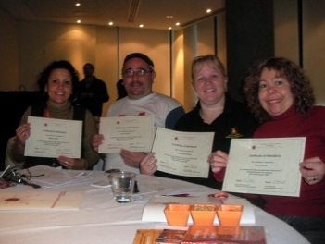
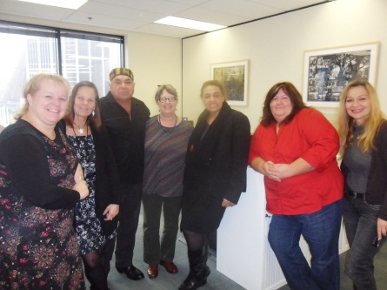
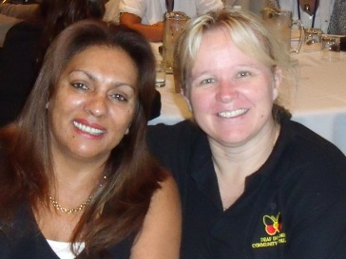





Cultural Dimensions
Quad Lateral Influence
Norms
Values
Experience
Language

Slide 10







Communication Paradigms quad-lateral impacts
Non – Indigenous people
Power
Indigenous peoples
visualisation
People with Disabilities
collective
Indigenous People’s with Disabilities
Emerging

Slide 11
Outcome Driven
Evidence based approaches MUST have achievable life choices
Cultural capital verses Exceptionalism – collective approaches to deliverable services
Established NEEDS based norms
Expectations – needs adaptability

Slide 12
Outcome Driven
Independent and transparent planning
Complaints processes
Need to be aware of the concept of truth….
Inherent dignity in communication
Self-care
Audism
Communication respect
Timing

Slide 13
Evidence – real life stuff !!!
Jill
Jack
Is profoundly Deaf
Family : don’t speak English
Nurses: use symbols
Audiologist: uses lip patterns and mime
Jill has her Medicare/pension card/ ID
Jill doesn’t return to the Audiologist?...how come????
Has an Acquired Brain Injury
Has had foot amputated
Suffers from slurred speech
Physiotherapist: uses cue cards and pictures
has moved from interstate and waiting on records
Why does Jack have difficulty coming to appointments ??
Notes:
Ok : I want to ask you a question???
Feedback

Slide 14
Inclusive Practice
Jill
Jack
Cultural Safety
Communication access
Assessment of surrounding
Assessment of professionals
Shame
Intimidation
Visual traffic
Expectation
Cultural Safety
Communication access
Ability verses capability
Expectations
Gender
Timing
Past treatment
Colour
Notes:
Based on feedback

Slide 15

Early Interventions
Establishing local and community connections around disabilities and carers.
Understanding and learning barriers faced by community members with deafness and disabilities.
Seek supports of families, kinship groups and services to support you in your work with clients with deafness and disabilities
Notes:
How can we do it better

Slide 16

Elders with Disabilities and Carers
Seek supports from Elders with disabilities or are carers
Establish support contacts for clients amongst Elders groups to advocate for clients inclusion into community
Work with Elders to ensure access to health related events are available to your clients
Notes:
Who to engage with

Slide 17

Knowledge
Understand your own limitations
Be aware of your own involvement
Report when difficulties occur
Use your knowledge to empower others
Shared knowledge is vital to achieve needs based outcomes
Notes:
Sharing knowledge

Slide 18

Self-Care
Time limits
Availability
Community support
Training and developing
Time OUT
Notes:
About you !!!

Slide 19
Contact
Jody Saxton-Barney
CEO
Deaf Indigenous Community Consultancy
Email: info@deaficc.com
Mobile: 0400098370
“Giving the Community a Voice & Making it Happen”
Website: www.deaficc.com
Notes:
How you can find me

