Slide 1
AHPs in Indigenous Primary Health Care
A View from the Northern Territory
John Paterson
Rob Curry

Slide 2
Presentation Summary
AMSANT
Context of remote Australia
AHPs in Remote Health
Aboriginal PHC Reform in the NT
AHPs in NT PHC Reform
Key issues for consideration

Slide 3
AMSANT
The Aboriginal Medical Services Alliance of the Northern Territory
Peak body for 24 Aboriginal community controlled health services in the NT

Slide 4
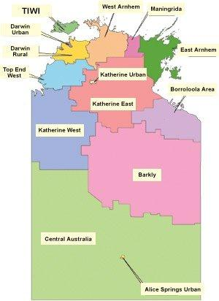

Slide 5
AMSANT
Our Vision
Improve the health of Aboriginal Territorians
Key Strategies
Build support for member organizations
Strengthen leadership amongst membership
Advocate for health equity
Build effective relationships in Aboriginal health
Grow the community controlled sector

Slide 6
Aboriginal Community Controlled Health
Independent incorporated health organizations (170 around Australia)
Elected Aboriginal Boards of Management
Principal funding source: DoHA
Answerable to communities & funders
Committed to comprehensive PHC
Committed to Closing the Gap
NACCHO as national peak body

Slide 7


Slide 8
Healthcare in Remote Australia

Slide 9
Remote Health Context
30% of Australians live in rural/remote regions – about 7 million
5% live in remote Australia – about 1 million
Rural/remote health is worse than metro
Health deteriorates with distance from cities
Reasons for poorer health - social determinants
Poorer access to services; eg. health, transport, education, etc.
Many Aboriginal people live remote

Slide 10
Remote Health Context
Productivity Commission report on Australia’s Health Workforce (2005):-
“The importance of providing appropriate, sustainable, high quality health care to all Australians, regardless of their socio-economic circumstances or geographic location, is paramount.”

Slide 11
Remote Health Context
Different Healthcare Models Needed for the Bush
“Providing services for people in rural/remote areas where the population and service infrastructure is sparse presents particular challenges for both government and community sectors. These include additional costs, lack of service infrastructure and service options, transport difficulties and difficulties in recruitment and support of staff …”.
Chenoweth & Stehlik

Slide 12
Remote Health Context
Remote communities lack scale for services
Remote residents must access care from larger towns & cities.
Do we deliver services to people or people to services?
Limited service access results in unmet needs & poor health outcomes.
Must build/expand local PHC services

Slide 13
The NT is Remote
Vast geography – same size as South Africa
Unique population demographics
Poor health picture
Health service delivery arrangements
- 5 regional hospitals
- Mainstream general practice
- Urban community health
- Private AHP services
- Aboriginal PHC (largely remote)

Slide 14
NT Demographics
Vast area, sparse population = 220,000
Aboriginal people are 30% of population
Darwin = 120,000; Alice Springs = 30,000
Most people in remote areas are Aboriginal
Many small remote Aboriginal communities
Unique jurisdiction

Slide 16


Slide 17
Remote AHP Services

Slide 18
AHPs in Remote Health
Limited AHP services in the bush. Why???
AHPs, nurses & AHWs are States responsibilities
Medicare covers doctors (Commonwealth funding)
Poor State funding for AHP services in the bush
No national approach to developing comp PHC
Consequence - limited development of remote AHP services.

Slide 19
AHPs in Remote Health
Low per capita AHP services in remote
Example physiotherapy. High per capita rates in big cities, low rates in NT (AIHW, 1998)
Adelaide – 1:1300 NT = 1:2500
Medicare supports urban General Practice
Medicare fails to support multi-disciplinary PHC
Market failure for health care in remote

Slide 20
National Healthcare Reform & AHPs
Nicola Roxon (Federal Health Minister, 2008)
“ Prevention of illness and chronic disease is central to a sustainable health system and a fuller life for all members of the Australian community. Too often in the past, individuals, communities and governments have focused on the immediate issues of treating people after they become sick. Whilst this will always remain vital, and there is much to do in this area, we cannot afford to limit our focus to treatment and ignore prevention.”

Slide 21
National Healthcare Reform
AHPs fit well with comprehensive PHC & prevention
AHPs trained in effective health promotion
To build comp PHC, must build AHP workfrce
Reform Medicare ie. universal ‘health’ care, not just ‘medical’ care
Medicare Locals offer some hope for reform

Slide 22
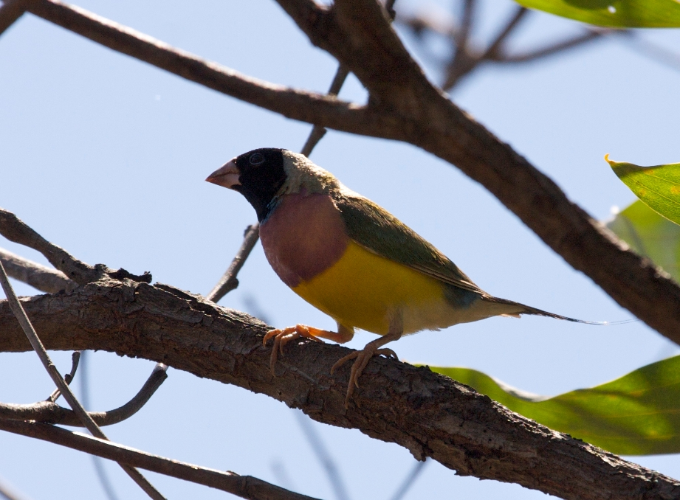

Slide 23
Aboriginal PHC in the NT

Slide 24
Challenges for Aboriginal PHC in NT
High Aboriginal morbidity/mortality
Workforce shortages, particularly AHWs & AHPs
Lack of Aboriginal people in health workforce
Dispersed population, isolated communities
High service delivery costs for remote
Market failure for health care – dependence on grant funding

Slide 25
Reforming NT Aboriginal PHC
Advocacy for PHC reform for 30 years
NT Aboriginal Health Forum is key reform body
Forum includes:-
- AMSANT
- NT Health
- Commonwealth Health

Slide 26
Key NT PHC Reforms
Pathways to community control of PHC
Regionalization of Aboriginal PHC
Core PHC services
Funding formula for equity
Expanded PHC services from Emergency Intervention & now Stronger Futures

Slide 27
Regionalization of PHC
14 regional Health Service Delivery Areas (HSDAs)
Each comprised of 2,000 – 4,000 people
Each a centre for PHC planning
Focus on community level services, not vertical programs
Each HSDA funded for equitable PHC services
All based on comprehensive PHC model
All to become Aboriginal community controlled

Slide 29
Core Primary Health Care Services
Expanding community based PHC services to include areas of:-
- Chronic Disease management
- Mental health
- Alcohol & other drugs
- Child, maternal, family services
- Aged/disability care
- Dental and oral health
- Health promotion

Slide 30
Principles of Core PHC Services
Bringing services closer to remote residents
Horizontal program development over vertical programs (visitors)
Improved capacity for health promotion
Supporting local Aboriginal workforce
Engaging the community
Address broader social determinants of health

Slide 31
Progress with CTG in NT
Age-standardised death rate per 100 000, actual and projected rates, by Indigenous status, Northern Territory, 1998–2031

Slide 32
Indigenous Mortality Rate Comparisons
 | 1998 Mortality Rate Per 100,000 | 2010 Mortality Rate per 100,000
NSW | 920 | 956
Qld | 1310 | 1096
SA | 1259 | 1181
NT | 1933 | 1432
NT non-Indigenous | 764 | 584

Slide 33


Slide 34
AHPs in Aboriginal PHC

Slide 35
Features of NT Aboriginal PHC
14 HSDAs, each with 2,000–4,000 people
Some HSDAs contain several geographical sites/towns, but under 1 governance structure
Each HSDA employs a comprehensive team covering Core PHC areas
Some resident health professionals, others visit from a central base.

Slide 36
AHPs in Remote Aboriginal Health
AMSANT proposes 3 levels of AHP engagement at remote community level
AHPs in Comprehensive PHC
AHPS as members of regional Hub Support services
AHPs as part of Specialist Outreach services

Slide 37
AHPs Embedded in PHC
PHC services need expansion to include:-
- Chronic Disease management
- Mental health
- Alcohol & other drugs
- Child, maternal, family services
- Aged/disability care
- Dental and oral health
- Health promotion

Slide 38
AHPs in Aboriginal PHC
Range of AHP services needed in Aboriginal PHC within HSDAs:-
Dietetics/Nutrition
Environmental health
Oral hygiene/dental therapy
Occupational therapy
Physiotherapy
Psychology
Social work

Slide 39
Key AHP Roles in Aboriginal PHC
Assessment
Treatment
Health education/promotion
Therapeutic equipment
Advocacy
Project development/research
Liaison with the PHC team
Liaison/referral to special programs

Slide 40
Physiotherapy Example
1 registered physio per 1,200 Australians
Each PHC HSDA has 2,000 – 4,000 people
Therefore, each HSDA should have 2 or 3 physios
Current situation in NT – approx 1 physio per 5,000 remote Aboriginal people

Slide 41
AHPs in Aboriginal PHC
AHPs that could be added to PHC based on local health profiles/priorities:-
Audiology
Diabetes education
Pharmacy
Podiatry
Speech pathology

Slide 42
Barriers to AHP in Remote PHC
No viable private practice
Lack of knowledge of AHPs – limited demand
Lack of state government funding
Urban-centric models of care/planning
Dominance of hospital/specialist care
Lack of preparation on AHPs for comp PHC roles

Slide 43
AHPs in Hub Support Services

Slide 44
Concept of Hub Supports
Not specialist services
Focus on supporting PHC level of care
Regionally planned, not central planning
Strong community engagement/consultation
Need effective management /auspicing agency
Best working hub model for AHPs – NW Qld Allied Health Services

Slide 45
AHPs in Hub Support Services
AHP Hub Support providers are generalists
Many sources of Hub Support AHPs
Difficult for PHC to integrate some AHPs
Move hub supports to PHC level when/where possible
Hub Supports required for foreseeable future
Some AHPs could be placed permanently at Hub Support level

Slide 46
AHPs in Hub Support Services
AHPs best placed with Hub Supports:-
Audiology
Diabetes education
Optometry
Podiatry
Speech pathology

Slide 47
Barriers to regional Hub Supports
Central placement/planning of Hubs
Lack of focus on community priorities and PHC
Lack of capacity of non-gov sector to run Hubs
Limited options for a Hubs Manager
Limited coordination of the various Hub providers

Slide 48
AHPs as Specialist Outreach

Slide 49
AHPs as Specialist Outreach
Specialist trained AHPs from specialist settings
New funding under COAG MSOAP Indigenous Chronic Disease Package
$474 million over 4 years for multi-disciplinary specialist outreach
Areas for focus are:-
Diabetes
Cardiovascular disease
Chronic respiratory disease
Renal disease
Cancer

Slide 50
AHPs as Specialist Outreach
Some Allied Health professions are credentialing specialist practitioners
Physiotherapy
Psychology
Podiatry
Social Work
All AHP professions support specialist training
All AHP professions are potential members of specialist outreach teams in Aboriginal health

Slide 51


Slide 52
Where to From Here
PHC level of healthcare needs major development
Focus on horizontal programs, not vertical
AHPs are an essential part of comprehensive PHC
Aboriginal health needs more AHP input & resources
Build Hub Support service structure
Integrate AHP specialist outreach in support of PHC
Focus on regionally health planning and managed, not central

