Slide 1
The health and wellbeing of Aboriginal people in prison: findings from The NSW Inmate Health Survey
Indigenous Allied Health Australia National Conference
November 2012
Jude Page
Project Manager, Aboriginal Health

Slide 2
Acknowledgements
2009 Inmate Health Survey (IHS), Investigators: Devon Indig, Libby Topp, Elizabeth McEntyre, Bronwen Ross, Peter Kemp, Denise Monkley, Martin McNamara, Robyn Rosina, Stephen Allnut, David Greenberg, and Edouard Tursan D’Espaignet.
IHS Aboriginal Health Report, Authors: Devon Indig, Elizabeth McEntyre, Jude Page and Bronwen Ross.
Funding: NSW Health: (Mental Health and Drug and Alcohol Office, Centre for Epidemiology and Research, Centre for Health Protection) and Justice Health

Slide 3
Overview
Background – to imprisonment
        – to the survey
Methodology
Results
  - Social Determinants
  - Risk Behaviours
  Chronic diseases
  Infectious Diseases
Conclusions

Slide 4
International Incarceration Rates, 2008
Source: World Prison Population List (eight edition), December 2008. Kings College London.
Note: Australia is cited in this report using ABS figures as 129 per 100,000 for 30/6/2008; however ABS reports Australia as having 168 per 100,000 at 30/6/2008 in its Prisoners in Australia publication (cat 4517.0), 2009. Note: This data may include both adults and juveniles in some countries.

Slide 5
Adult Incarceration Rate by State 2009
Source: ABS Prisoners in Australia, 2009. ABS Cat no 4517.0
.

Slide 6
Adult Incarceration Rate by State and
Indigenous Status, 2009
Source: ABS Prisoners in Australia, 2009. ABS Cat no 4517.0

Slide 7
Background to imprisonment
Individual factors
Effects of colonization
Social determinants of health (housing ,education, employment, poverty etc)
Mental health, disabilities
Other risk factors
Structural factors
Laws and policies
Policing
Sentencing
Bail laws & conditions
Access to health & support services
Availability of diversion options

Slide 8
Change in Aboriginal Custodial Population, NSW 1998-2012
 | 1998 | 2009 | 2012 | SOURCE
Custodial Population | 7824 | 11160 | 9624 | CS NSW Inmate Census
Male (%) | 94 | 92 | 93.5
Female (%) | 6.2 | 7.7 | 6.5
Aboriginal Male (%) | 13.5 | 21 | 22
Aboriginal Female (%) | 20 | 28 | 30
Source: NSW Inmate Census 2009, CSNSW 2012, Offender population report, CSNSW 30 September 2012. Totals include full-time inmates and period detainees.
Nationally 71% increase in Indigenous imprisonment between 2001 and 2009, compared to 25% increase for non Indigenous prisoners
(ABS, 2009)

Slide 9
Risk factors for Aboriginal prosecution & imprisonment
Major risk
High risk alcohol consumption
Illicit drug use (Weatherburn, et. al 2006, NATSIS)
Increase risk
Not completing year 12, unemployment, overcrowded housing, homelessness, being removed from family as child (incl. stolen generations)
Breach of bail conditions
Violent offences (assault, robbery)

Slide 10
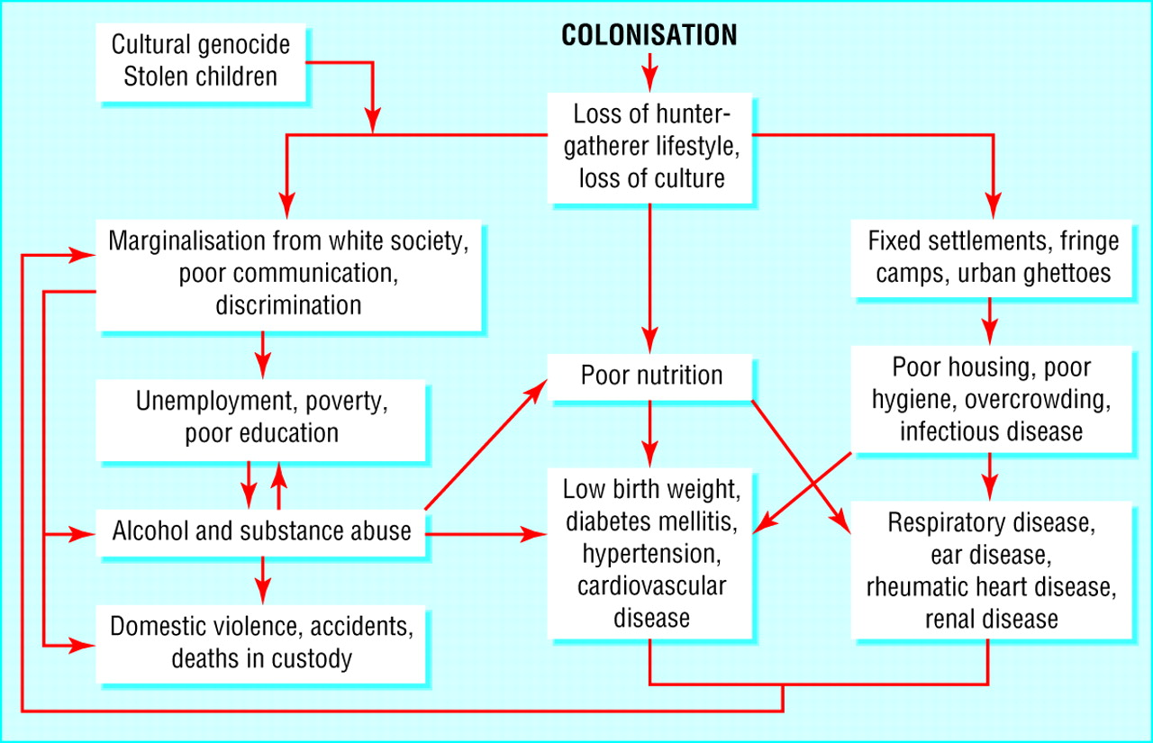

Impact of colonisation on Aboriginal health today. Modified from Mathews5
Cunningham, C. et al. BMJ 2003;327:403-404
Copyright ©2003 BMJ Publishing Group Ltd.

Slide 11
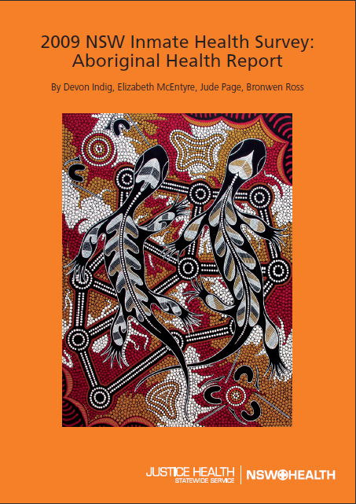

Slide 12
Research Methods
The Aboriginal Health Report is the first report of the health of Aboriginal adults in NSW prisons.
A snapshot of Aboriginal people within a larger study of Inmates in NSW Prisons
Acknowledged as one of the world’s most comprehensive assessments of prisoners’ health

Slide 13
Research Methods
  Random sample of 996 people (over-sample of women and Aboriginal people)
    31% identified as Aboriginal (312 people)
    Average age 35 years
  Exclusion criteria: non-English speaking, acute mental illness, profound intellectual disability
  Computer-assisted telephone interviews
  Average interview length 73 minutes
  Response rate: 85%

Slide 14
Survey content
Physical health tests – physical measurements, blood pressure, blood sample (blood borne viruses, blood sugar, etc), urine sample (STIs, etc)
Physical health – prison history, demographics, health status, disability, medications, asthma, diabetes, exercise, injury, SF-12, diet, etc
Access to healthcare – in prison and community
Mental health & risk behaviours– psychiatric history, suicide, self-harm, smoking, alcohol, drugs, tattoos, sexual health

Slide 15
Healthcare access in community (ever),
Inmate Health Survey 2009
 | Aboriginal Men (N=259) | Non-Aboriginal Men (N=538) | Aboriginal Women (N=53) | Non-Aboriginal Women (N=146)
No health services | 27% | 12% | 6% | 4%
Hospital | 45% | 59% | 62% | 68%
GP | 40% | 69% | 60% | 87%
Medical centre | 39% | 41% | 70% | 58%
Community health centre | 25% | 21% | 36% | 39%
Home nursing | 5% | 3% | 23% | 4%
Other | 16% | 7% | 32% | 19%
Notes:
14

Slide 24
Summary – Social determinants
Aboriginal inmates had worse social determinants of health than non-Aboriginal inmates:
  Nearly twice as likely to not complete Year 10
  More likely to be unemployed (often long-term) prior to prison
  Nearly three times as likely to have had a parent in prison
  Twice as likely to have been placed in care as child
  Twice as likely to have ever been in juvenile detention
  More likely to have been in prison previously
Notes:
23

Slide 25
Risk Behaviours

Slide 28
Smoking characteristics
Average Aboriginal inmates smoked at approximately double the rate of Aboriginal people in the community (85% vs 45%)
A third of participants smoked by the time they were aged 12.
Aboriginal inmates smoked less cigarettes per day (approximately 20% of Aboriginal inmates smoked 21+ per day compared to about 30% of non-Aboriginal inmates)

Slide 30
Drinking characteristics
Over a third (35%) of Aboriginal women did not drink any alcohol in the year before prison, compared to 31% non-Aboriginal women.
Nearly half (44%) of Aboriginal men scored 20 or more on the AUDIT, indicating alcohol dependence
58% of Aboriginal men reported usually drinking 10 or more drinks on a typical day (compared to 41% non-Aboriginal men)
40% of Aboriginal men reported they had 6 or more drinks on a daily basis in the year before prison (compared to 27% non-Aboriginal men)

Slide 36
Summary – Chronic Diseases
Aboriginal inmates had high rates of chronic diseases than non-Aboriginal inmates:
  Twice as likely to have diabetes
  Twice as likely to have ever had asthma (Aboriginal women)
Aboriginal inmates had higher rates of infectious diseases than non-Aboriginal inmates:
Notes:
35

Slide 37
Chronic diseases characteristics
Nearly all (91%) Aboriginal women were currently taking medications, compared to 84% non-Aboriginal women and two-thirds of both Aboriginal and non-Aboriginal men
Over half of women (59% Aboriginal women and 54% non-Aboriginal women) self-reported having 3 or more health conditions compared to about 40% of both Aboriginal and non-Aboriginal men

Slide 40
Summary – Infectious Diseases
  More likely to be Hepatitis C antibody positive
    But decreasing
  Twice as likely to be Hepatitis B core antibody positive (Aboriginal men)
    But decreasing
  A third of Aboriginal men (32%) reported ever being diagnosed with a sexually transmissible infection (30%) and Aboriginal women (26%). NOTE: usually no symptoms
    Not decreasing
Notes:
39

Slide 41
Infectious diseases characteristics
One inmate tested positive to HIV antibody
Aboriginal men - higher rates of testing for a blood borne virus in prison (61% vs 47%) compared to non-Aboriginal men.
Aboriginal women - best knowledge of risk factors for Hepatitis C transmission (54% correctly answered 3 risk factors).

Slide 42
Conclusions
Over representation of Aboriginal people in prisons
Social determinants of health (poor educational attainment, family displacement, unsettled accommodation) impact on health
Higher prevalence of risk factors for chronic diseases such as smoking, risky drinking and illicit drug use
Aboriginal inmates are more likely to have chronic and infectious diseases, which start at a younger age – mostly preventable
Notes:
41

Slide 43
Where to from here?
Utilising the evidence to inform policy and program development and to seek enhanced funding and services
Need for government to work more closely with Aboriginal people to break the cycle of crime, disadvantage and poor health
Prison presents an opportunity to screen for chronic and infectious diseases, provide treatment, health education and strengthen self management
Improving culturally responsive services to Aboriginal people in custody and access to health care on return to community
Notes:
42

Slide 44
What is our role?
Reduce risk factors for poor health
Treat effects of trauma
Improve access to appropriate health care, support & follow up
Make the health care experience relevant and positive
Include health promotion and understanding in each health interaction (where appropriate)
Model of health: patient centred, holistic
Support healing & healthy communities
Education, inclusion, opportunities
Notes:
43

Slide 45
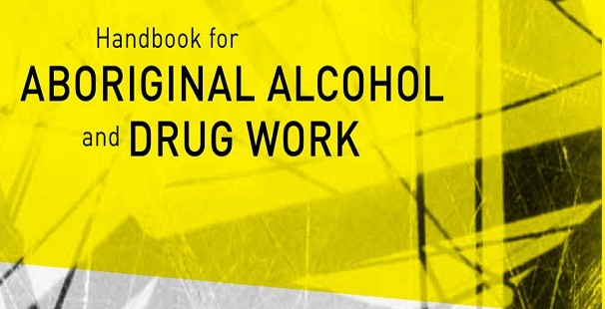
Tools http://sydney.edu.au/medicine/addiction/indigenous/resources

Slide 46

Future research
Aboriginal Men in Custody Study
  Focus on experience of criminal justice system, resilience, racism and mental health – using Inmate Health Survey cohort
  Study of experiences of 125 men is being finalised
Notes:
45

Slide 47
Thank you
Questions?
Jude.Page@justicehealth.nsw.gov.au
Tel (02) 8372 3076 | Mob 0400 237 272
Notes:
46

