Slide 1
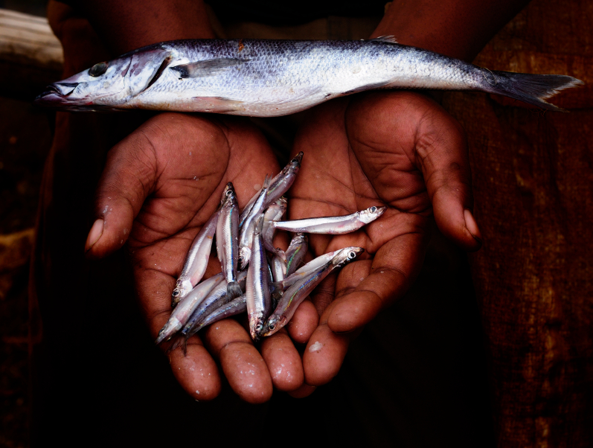
Trauma

Slide 2
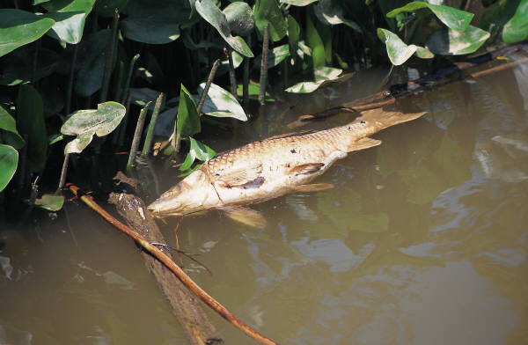
The effects of Trauma?

Slide 3
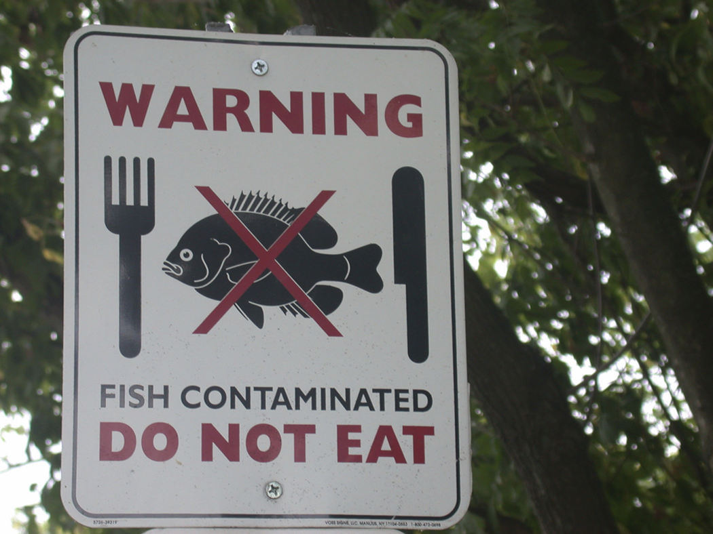
Generational Trauma?

Slide 4
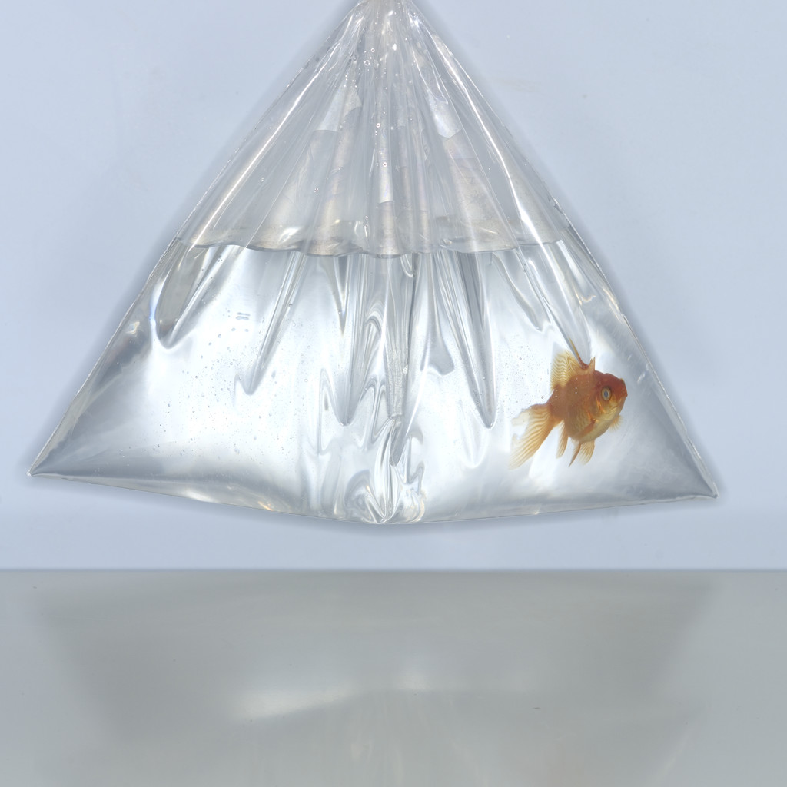
Secondary Trauma?

Slide 5

Trauma exposure response

Slide 6

Risk & Resilience

Slide 7

Could we, Should we?

Slide 8

Together

Slide 9

Thank you for sharing together.

Slide 10

References

Slide 11
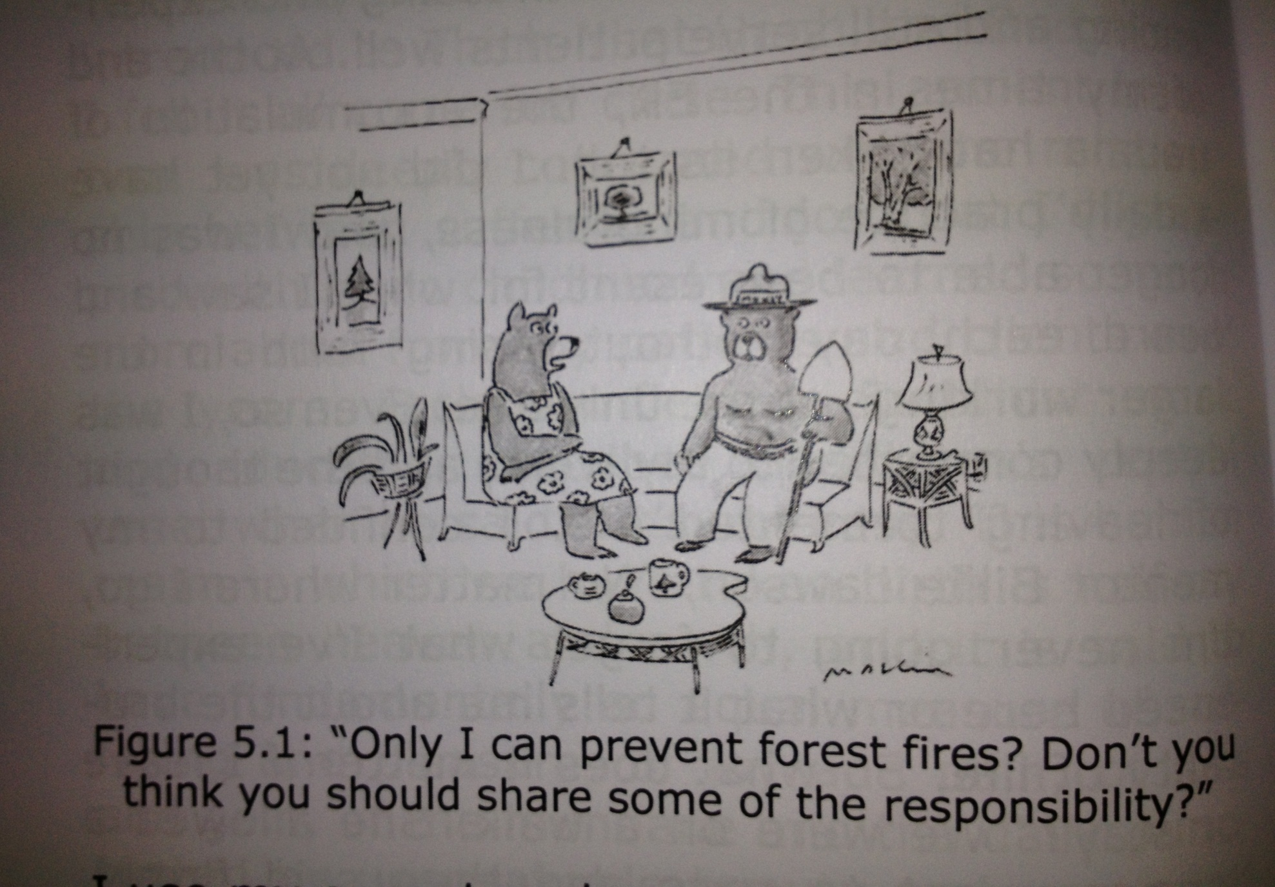

Slide 12
