Slide 1
Nicole Turner Aboriginal Nutritionist
I would like to acknowledge the traditional owners past and present of this beautiful land I stand on today, and thank them for allowing me to be here.

Slide 2


Slide 3
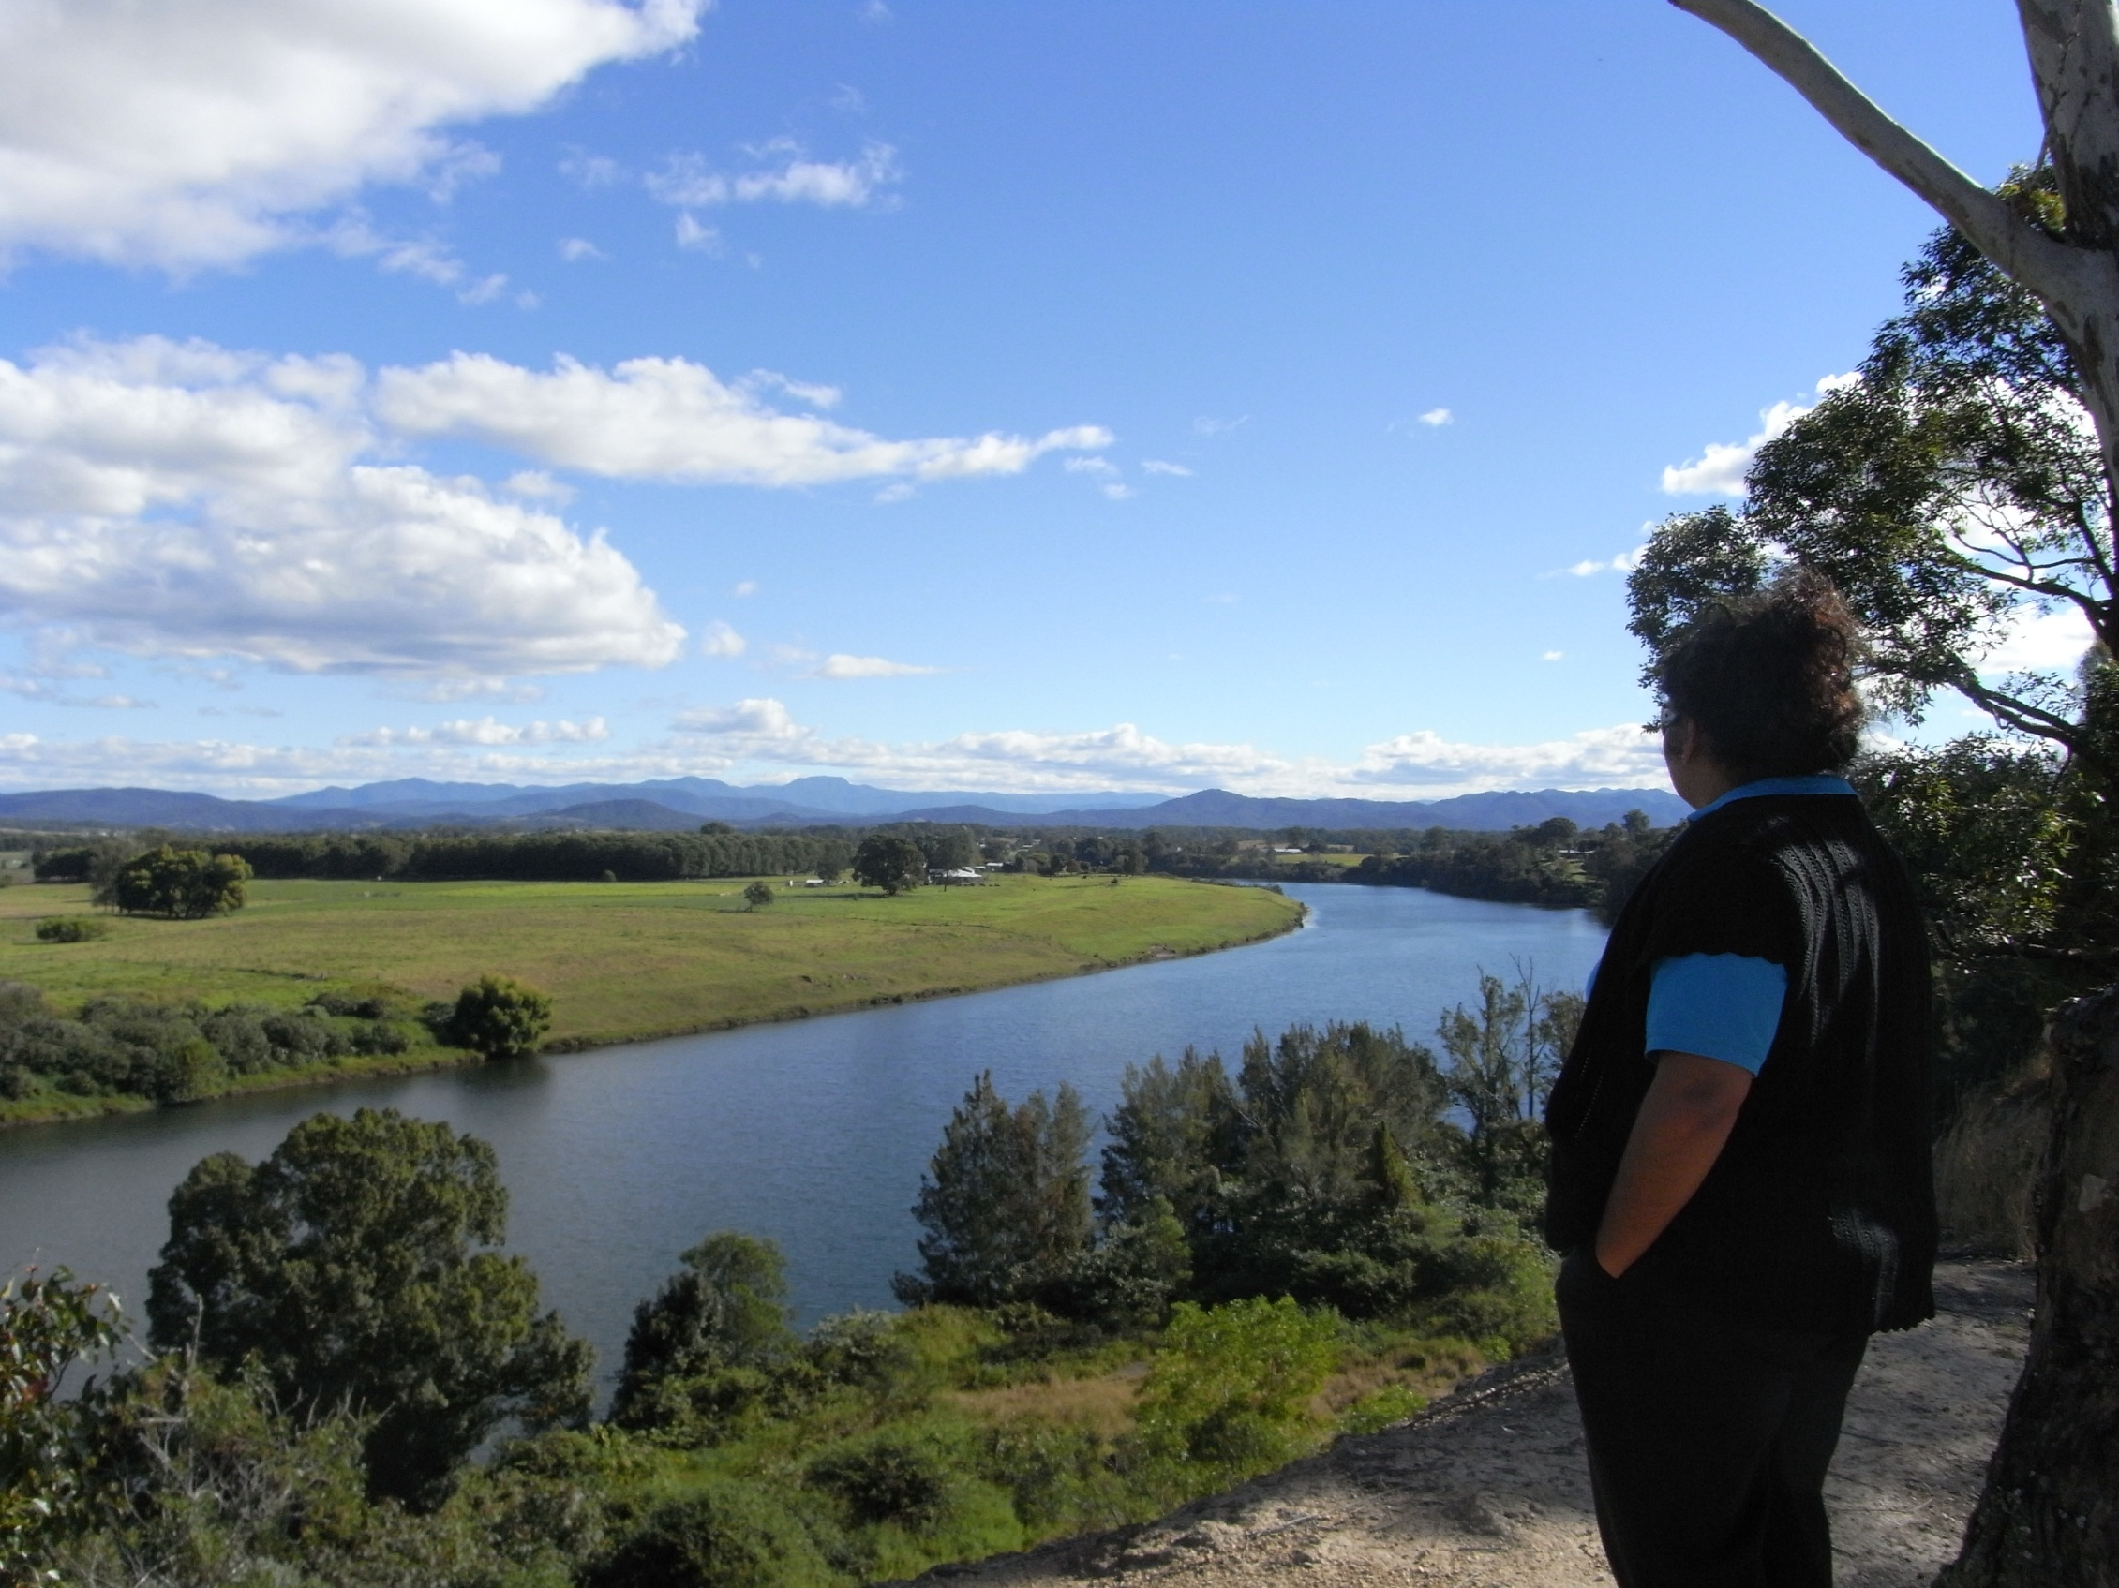
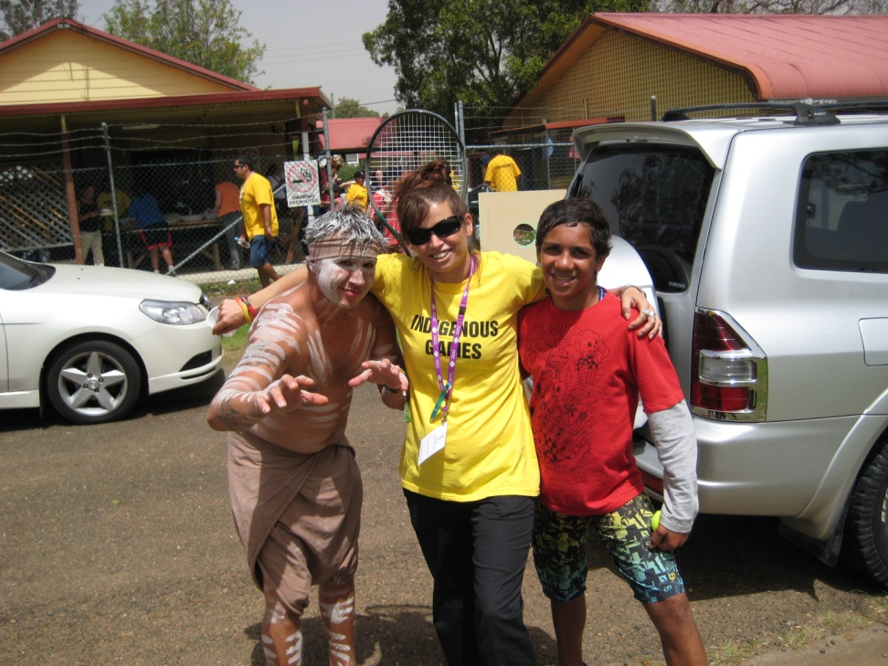
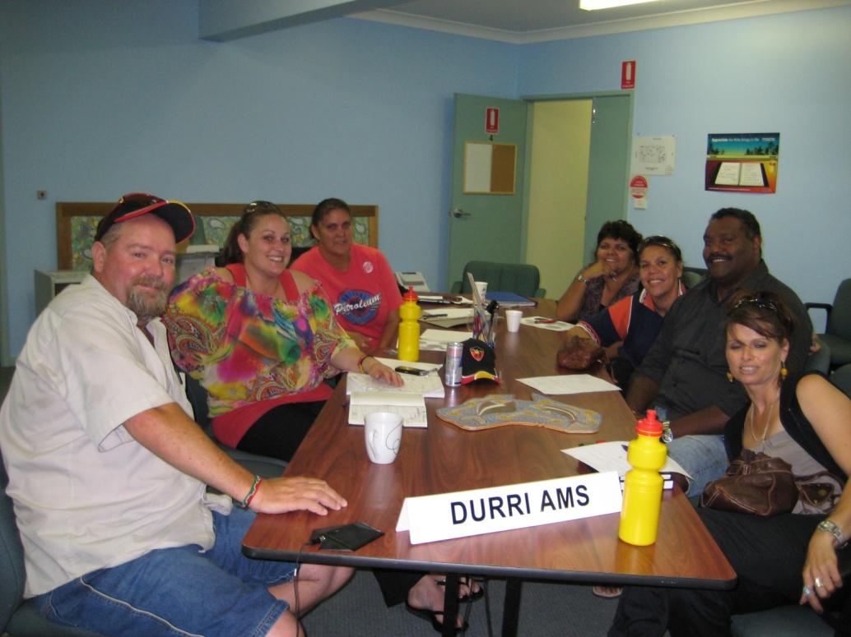
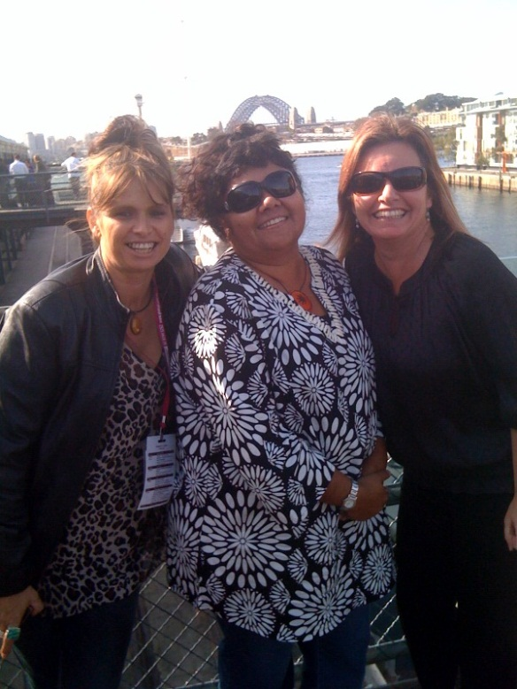
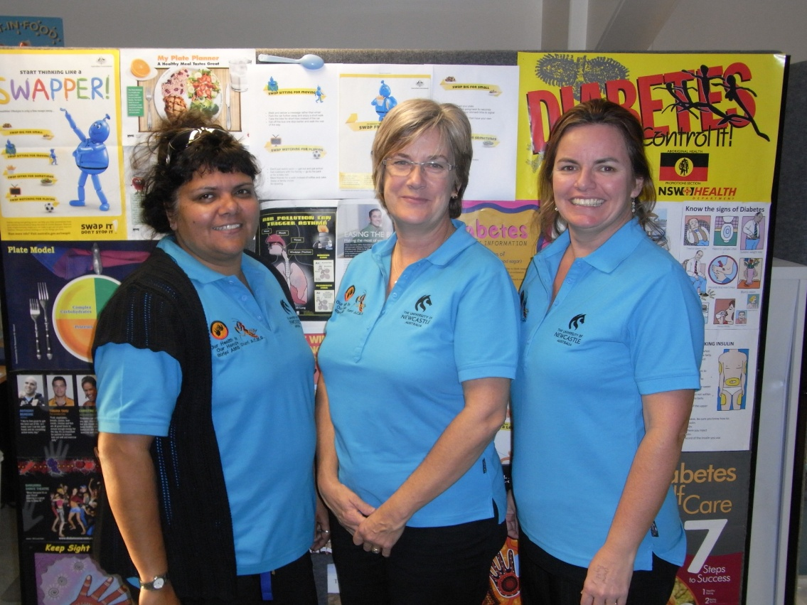
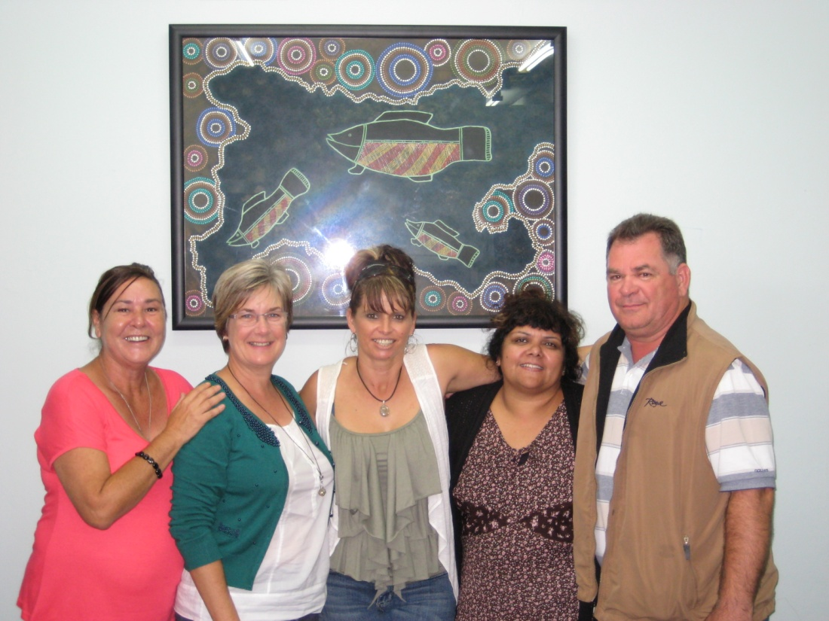

Slide 4
My journey.
Started many years ago.
Shocked at the results from research that I gathered
I know I had to do something about it
Looked into where and how I can do a course with 4 kids and full time work.

Slide 5
How many Aboriginal Nutritionist ???
Good question ???
I'm 1of Five that I know about in Australia
We need so many more
What are our people dying from ???, mostly preventable diseases
A lot of the gap is related to risk factors such as obesity and physical inactivity, which nutrition plays a large role in.
And the current “GAP”, differs in many areas

Slide 6
What change has to be made
Capacity building of nutrition workforce
Education delivered by Aboriginal people
Make community aware of problems and where they can help.
Its about prevention and looking after our young kids before that get chronic diseases.

Slide 7
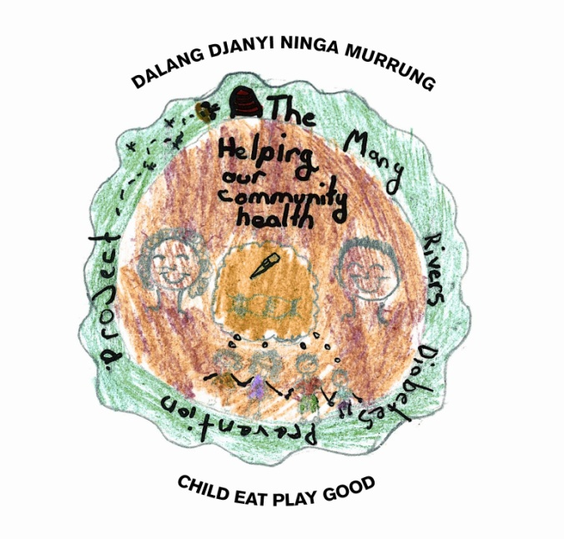
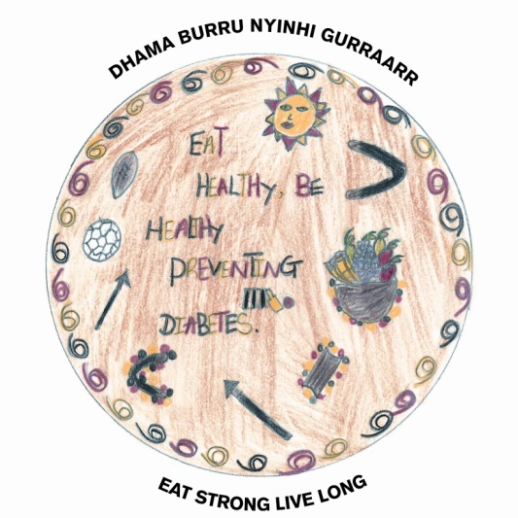
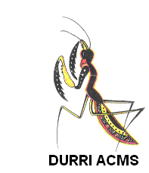


Many Layers of the Many Rivers Diabetes Prevention Project.…
The Many Rivers Diabetes Prevention Project.
Nicole Turner
Manager Health Promotion
Notes:
Thank you.

Slide 8
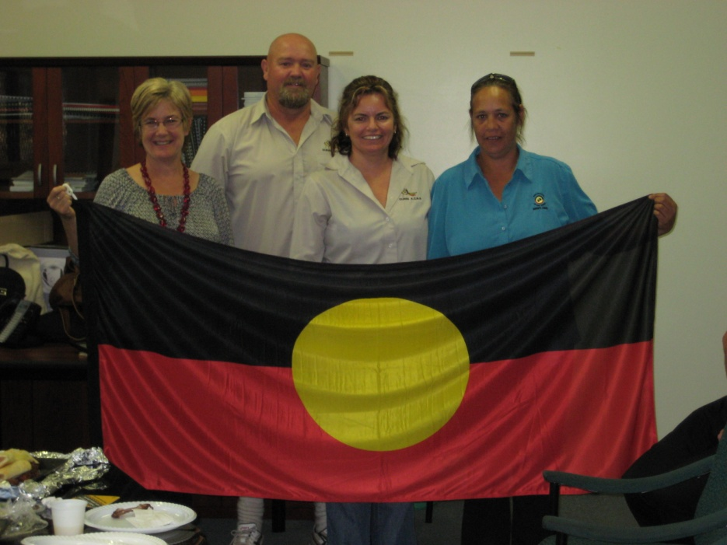
Background
Initiative of Durri ACMS in Kempsey N.S.W.
Started in 2000
‘To prevent children from growing up to get Diabetes’
University of Newcastle
Biripi ACMS in Taree
Durri ACMS in Kempsey
Awabakal AMS in Newcastle
Centre for Public Health Nutrition at University of Sydney
Associate Professor Vicki Flood – University of Wollongong.
Notes:
The Many Rivers project focuses on Diabetes prevention with Aboriginal children (although include all children as requested by our partner organisations). We address the lifestyle risk factors of food habits and physical activity participation as well as knowledge about Type 2 Diabetes.
The Many Rivers project has undertaken a range of studies on physical activity, food and nutrient intake as well as the validation of self report surveys.
This presentation presents some key results of the food and nutrient intake study., we also have a publication in final draft.
I will discuss these results in the light of community focus groups undertaken in another study in the project.
Food security here is addressed in the broad sense
The project is a partnership of …….
Study undertaken with the support of the Centre for Public Health Nutrition at University of Sydney
Particular acknowledgement to Assoc Prof Vicki Flood who is now at the University of Wollongong who was instrumental in the designing the study, in managing the data, in guiding the pending publications, and without whom this work would not have been undertaken.

Slide 9
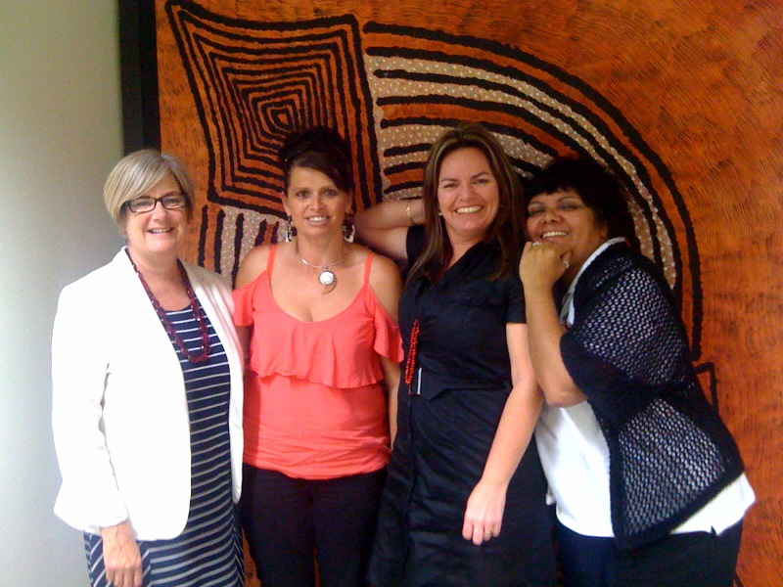
My Team

Slide 10
Staff and Project
3 fulltime Aboriginal staff (NSW ministry of health )
20 casual Aboriginal staff (survey workers)
Research and data Manager.
Many partnerships and Linkages – local councils, Red cross, Education Dept., Universities, AMSs, Cancer council, Menzies, NSW health, OATSIH.

Slide 11
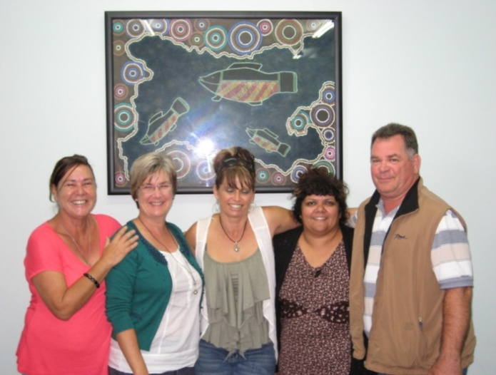
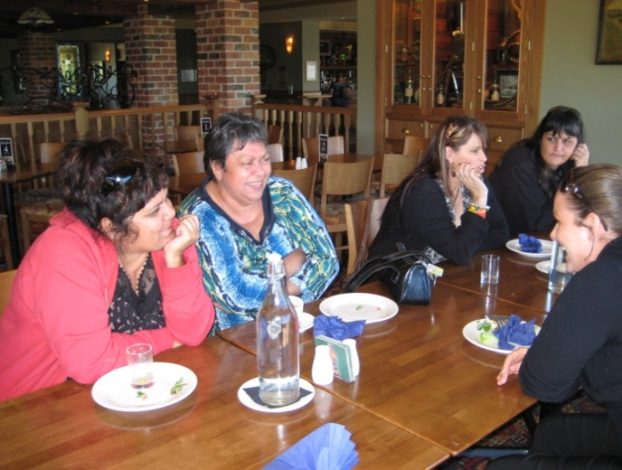
PROCESSES to SUPPORT COMMUNITY CONTROL
MOU’s /data access agreements
Co-management of the project
Community directed not “tweaking the mainstream”
Intellectual property:
Authorship
Acknowledgements
Other
Return of data to community
Very Unique project, consisting of research and health promotion.
Notes:
MOU’s etc
MOU’s with partner organisations/ experts / temporary partners eg Red Cross
Access to data by experts for the purposes of assisting with data management: statement of extent and duration of involvement , and date by which data returned
Co Management
Community Directed not ‘tweaking the mainstream”
Intellectual property which includes:
Authorship of all publications, reports, Conference and other presentations etc;
Acknowledgements
Artistic and photographic work
Return of data to community:
Under discussion
Initial issues;
Data may be of use in years to come – so keeping data longer that maybe required by ethics committees or the life of a proejct… and ensuring that kept ethically.
In the MOU between partners – data is to be returned to the representative of the community on the steering committee, and subject to advice from community reference group.
“Return of data” means also dissemination of results.
11

Slide 12
Governance structure
Multi levelled governance model
Publications including Aboriginal staff
Community involvement ,engagement and direction

Slide 13
Figure 1: ABORIGINAL COMMUNITY CONTROLLED GOVERNANCE STRUCTURE
ADVISORY GROUP (2 x year)
Expertise on the “National Picture” regarding Indigenous and Child Health and Well-being. Provide guidance on the direction, evolution and sustainability of the program; ways to address any barriers; meeting National Priorities/Initiatives in Indigenous and Child health (including ‘Closing the Gap’ Initiatives); advice on activities of other research programs to ensure that this program augments other work and aims to maximise benefits to participating Aboriginal communities
STEERING GROUP (up to 6 x year)
Managerial advice on every aspect of the project including planning and direction of each phase of the project; Intellectual Property matters (See Figure 2); collaboration matters between all partner organizations; financial management; accountability to funding bodies; community advocacy and governance; regional and organizational needs and issues that impact on the development and delivery of the program.
ABORIGINAL COMMUNITY REFERENCE GROUP (meets 6 to 8 x year dependant on activities of the project)
Provides community advice to the Many Rivers project on all aspects of the project includes: all publications and conference presentations vetted; development of research and health promotions activities and advice on benefit, feasibility and acceptability of these activities to their communities; community and partnership matters that impact on the delivery of the program; community controlled governance matters (see Figure 2).
METHODOLOGY GROUP (up to 1 x month dependant on strategies)
Advice on matters relating to research design and data analysis.
PROJECT IMPLEMENTATION GROUP
Co-Managed: Manager Research and Evaluation and Manager Health Promotion (the latter designated for an Aboriginal and Torres Strait Islander person)
All Project Officer positions are designated for Aboriginal and Torres Strait Islander people. Project Officers implement all strategies of the program in the communities and in doing so liaise and collaborate with other organizations / sectors involved in the project such as the schools and non-government organisations.
Notes:
JANINE
The reference group
STEVE
The Steering committee and working group
JO
The Advisory /methodology

Slide 14
Figure 2: DOCUMENTS TO SUPPORT COMMUNITY CONTROL AND GOVERNANCE These documents are regularly reviewed and updated , and others added to ensure relevance to all matters related to community control of research
Intellectual property
Authorship
Acknowledgements
Conference and other presentations
Reports
Artistic and photographic work
Indigenous cultural and intellectual property
Sharing of proceedings / benefits from published research or service delivery.
Memo’s of Understanding
between
All partners: over-arching MOU regarding intent and conduct of program
Individual partners: location and management of project staff (all positions designated for Aboriginal people) within partner organisation
External experts /others (such as NGO’s) and partners: statement of extent and duration of involvement in any component of the research program
Data agreements
Access to data by experts for the purposes of assisting with data management: statement of extent and duration of involvement , and date by which data returned
Return of data to community:
Results
Data

Slide 15
MANY RIVERS DIABETES PREVENTION PROJECT
AIM: To prevent children from growing up to get Diabetes
VALIDATION
of
Food and
Physical Activity
Surveys
COMMUNITY ASSET MAPPING
Focus Groups: parents,
children & community.
2. Mapped PA and food services
DESCRIPTION
Food Intake
Physical Activity
MANY RIVERS
PROGRAM
FOR
CHILDREN
GLYCEMIC INDEX
Methodology
Description
EVALUATION
Surveys
Food Intake
Physical Activity
STRATEGIES
Schools
GPs
Health assessments
WHAT NOW??
Surveys 2011-2012
Publications
More communities
Notes:
All children

Slide 16

Capacity building
Research is about capacity building of staff as much as the research.
“…giving something back to community...”
“…this will last long after you go…”
Skills acquired have a ‘ripple effect’.
Survey worker example:
Numbers / benefit
Training

Slide 17
Mean daily intake of nutrients
Nutrient | Boys (n = 93)
 | Aboriginal & Torres Strait Islander (n=34) | non-Indigenous (n=59)
Energy (kJ)* | 9689.2 | 8422.1
Total Fat (g) | 87.4 | 78.9
Monounsaturated fatty acids (g) | 31.1 | 27.7
Carbohydrate (g) | 289.1 | 241.7
Sugars (g) | 148 | 122.1
Starch (g)* | 139.7 | 118.8
Fibre (g) | 21.6 | 17.9
Sodium (mg) | 2934.5 | 2396.9
Notes:
Aboriginal and Torres Strait Islander boys demonstrate a higher intake of many of the 24 nutrients examined in this study when compared with their non-Indigenous counterparts from the same Socio-economic group. Shown here are those that are statistically significantly different (to 0.05 level).
*Nutrients with a Statistically significant difference <0.01.
This difference is not apparent in girls.
Aboriginal children show marginally non-significantly higher intake of saturated fatty acids when adjusted for gender and age and clustering within schools.
We consider that this difference is associated with the higher intake levels of EDNP and ‘poor choice’ foods of Aboriginal and Torres Strait Islander children in this population, a factor identified in this study and which will be shown in a later slide.
(T-tests conducted to examine this data (Kruskall Wallis for the non-normally distributed data).
(girls stat sig diff for beta-carotene).

Slide 18
Daily per capita quantity (gms) of highest ranking food categories contributing to energy, fat, saturated fat, sugar, fibre and sodium
Food Category | ATSI | Non-Indigenous | 2007 NNS*
Breads | 105.1 | 88.5
Milk | 282.3 | 273.3
Soft drinks, cordial, sports drinks | 441.5 | 297.1 | 364.7g
Higher fat processed meat | 61.7 | 57.3
Take-away meals | 41.1 | 30.6
Fruit juice | 208.3 | 153.4
Hot chips | 46.5 | 31.8 | 29.3g
Potato crisps and other salty snacks | 19.2 | 13.5 | 12.9g
Notes:
18
Difference in intake by Indigenous status is notable for many items including soft drinks and hot chips as well as potato crisps.
The much higher daily per capita consumption levels of soft drink for Aboriginal and Torres Strait islander children compared with non-Indigenous children is concerning. This per capita level is also considerably higher (by around120gms) than the per capita intake described in a Australian study of ‘extra-foods’ which used data from the 2007 National Nutrition Survey.
Per Capita Hot chips (wedges etc) intake is also consumed at higher levels than that described in this study – at 10gms per day more.
For both these foods the non-Indigenous data is comparable to the National Nutrition Survey data.
It is Aboriginal and Torres Strait Islander boys who are high consumers as reflected in their statistically significantly higher intake of a number of nutrients shown earlier.
Bread is highest contributor to energy, fibre and sodium for all children. It is worth noting that white bread is the highest food item in the bread category – of the 939 occasions of bread consumption in our recall database, only 74 were for wholemeal or grain bread.
We regard this food item as a ‘poor choice’ item. It is purchased in part because many types of white bread are affordable, usually the poor quality alternatives and is consumed in large quantities. We believe that consideration should be given to targeting white bread quality / alternatives / patterns of consumption as a health promotion strategy.
18

Slide 19
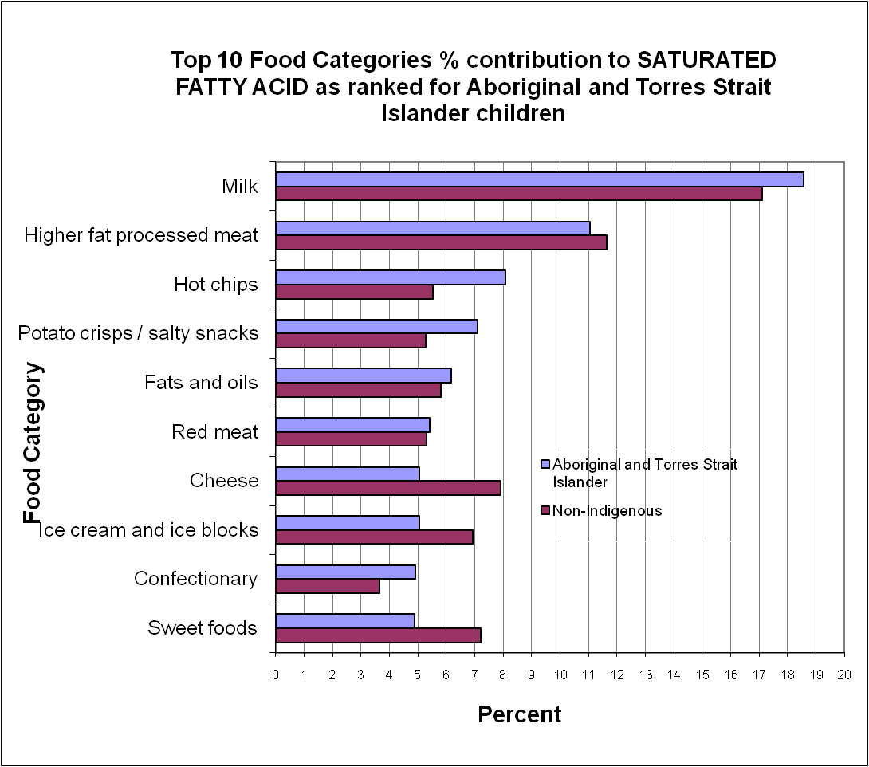
Saturated fatty acids
Saturated fatty acid contribution to energy is high for all children at around 15%.
2007 NNS = 13.6%
Notes:
Saturated fatty acid contribution to energy is high for all children in this population– and slightly higher than that found in the 2007 NNS.
Some differences by Indigenous status in top 10 foods contributing to saturated fatty acids are of note:
Hot chips (wedges etc)
Crisps
Cheese
* Adjusted for clustering within schools

Slide 20
Fruit and Vegetable intake
 | Aboriginal and Torres Strait Islander | non-Indigenous
Fruits | ½ serve | 2/3rd serve
Vegetables | 1 ½ serve | 1 2/3rd serve
2007 national child survey
1 serve
2 serves
Notes:
Aboriginal and Torres Strait islander children consume less fruit and vegetables than the non-Indigenous counterparts, and this is more apparent for fruit. This finding regarding fruit is born out in the limited literature that exists, and is probably around determinants of cost, availability and storage.
Consumption levels for all children in our population fall notably below that of children from the same age group in the 2007 NNS, particularly for Aboriginal and Torres Strait Islander children.
*It is important to note that the NNS results for fruit and vegetable intake are based on one day food intake data, that the population for this survey came from a wider SES band and that only 3% of participants were Aboriginal children
(150 gms = 1 serve of fruit
75 gms = 1 serve of vege0

Slide 21
Proportions Meeting Guidelines
Nutrient |  | Aboriginal | non -Indigenous
 |  | % | %
Fibre <AI |  | 77 | 79
Calcium <EAR | 9-11yrs^{f} | 65 | 60
 | 12-13yrs^{g} | 86 | 80
Potassium <AI |  | 62 | 66
Sodium >UL |  | 74 | 70
Majority of children fail to meet guidelines for key nutrient intake.
Some differences are evident by gender alone.
Nutrient | Boys | Girls | X² p-value
 | % | %
Fibre <AI | 84 | 74 | 0.04
Folate <EAR | 26 | 36 | 0.02
Magnesium <EAR | 15 | 28 | 0.04
Notes:
In this study many of these children from low SES communities fail to meet Australian guidelines for nutrient intake.
There is no statistically significant difference in proportion of children meeting guidelines for nutrient intake by Indigenous status nor when adjusted for gender. In our population of disadvantaged children, intake levels are of concern for all.
Notable are proportions:-
< AI for fibre and potassium
< EAR for calcium and this appears to increase with age and more so for girls (similar pattern to 2007 NNS)
> UL for sodium
Some statistically significant differences are evident by gender alone.
More Boys than Girls have less than the AI for fibre.
Girls > Boys do not meet guidelines for folate and magnesium. The proportion of children in this study not meeting guidelines for these micronutrients is far higher than reported in the 2007 NNS, and for girls this is 3 x higher for folate and magnesium.
There is an association between low intake of fibre and the micronutrients listed here, with the development of cancer, cardiovascular disease, type 2 diabetes, and neural tube defects all of which are at higher rates in Aboriginal and Torres Strait Islander communities.

Slide 22
Current stats
41% Aboriginal kids overweight/obese
Compared to 35% Non- Aboriginal kids
Underweight went from 4% to 15 % ????
75 % overall clients who have BMI stated.

Slide 23
Many Rivers Diabetes Prevention Project “health promotion strategies 2012-2013”
Deliver Diabetes education package in schools.
School canteens with a priority to high schools
Physical activity photo voice project
Traditional Indigenous games in schools
Social Marketing multi media campaign
Health support for children identified as overweight or obese from our previous survey
Explore Local store healthy food promotions
Aboriginal knockout health promotion activities for kids

Slide 24
Health Promotion Strategies
Community Directed / based on Research findings
SCHOOL: fruit breaks; veg gardens; diabetes education…
COMMUNITY: social marketing; fruit and veg boxes; TIGS comp; water fountains; Vending machines; bread promotion…..
COLLABORATIONS: Local Council; Red Cross; AECG….
HEALTH CHECKS: improve uptake in AMS’s
COMMUNITY DEVELOPMENT ROLE
CAPACITY BUILDING of STAFF
Notes:
24

Slide 25
Determinants
Environmental
Individual
Availability, Access, Affordability*
Public Transport*
‘Junk Food’ advertising
Government regulation*
Funding, sustainability and support for health promotion programs
Income / income management
Private Transport*
Education levels
Role Modelling*
Physical Activity levels*
Historical
RACISM
Cultural
Notes:
These food and nutrient intake patterns are associated with a number of food insecurity issues, and as described yesterday these are complex.
In this group of children from low socio-economic areas, a number of environmental and individual determinants are present for all and increased for Aboriginal children by factors that relate particularly to their communities.
Our community focus groups identify the following issues.
ENVIRONMENTAL
Availability of fresh and good quality foods other than in centre of town.
Access – Aboriginal communities often located at edge of town and this is historical – a result of relocation and marginalisation of communities away from mainstream.
Affordability – cost for all low SES families of sustaining a diet that meets healthy guidelines
Public Transport- poor infrastructure particularly for communities located on the edge of town etc .
Govt Regulation around obtaining traditional food.
INDIVIDUAL
Car ownership and availability is very limited in communities.
Role modelling - ie no Aboriginal people employed in the food service industry in 2 of the 3 regions participating and very few in the 3rd.
PHYSICAL ACTIVITY . In other work we have found that Aboriginal children tend to be more active than non-Indigenous and boys in general are known to be more active than girls. So this may explain food intake difference, higher energy needs, however needs to be examined further particularly in the light of the mortality and morbidity rates of Aboriginal men.
Factors particularly related to Aboriginal communities include:-
1. Historical – dispossession, dependant communities (both financially, no welfare available for Aboriginal people until well after non-Indigenous and for poor quality food handouts), geographically disadvantaged, marginalised.
2. Cultural – sharing with extended family “feeding the mob”.
3. Racism
Followed in shops etc
FINALLY by the age of our participants food behaviours are established. In addition many environmental factors intransigent. We conclude by saying that on the evidence of food and nutrient intake that we have gathered, and in the light of the determinants described, ‘closing the gap’ in rates of chronic disease in this population of children will not occur in their life-time.

Slide 26
Where to from here, Prevention and Protection.
More Education for parents
More Education in schools
More Education for communities, extending to other areas.
Increase health assessments and screenings
Screenings important for all age groups especially young boys.

Slide 27
REMEMBER
To have a successful project in a community it must have many layers.
This must include involving the community and knowing what the needs are . ????
We can not presume we know everything and what is right for the community.
Do a bit of researching before you start any new project.

Slide 28
Publications

Slide 29
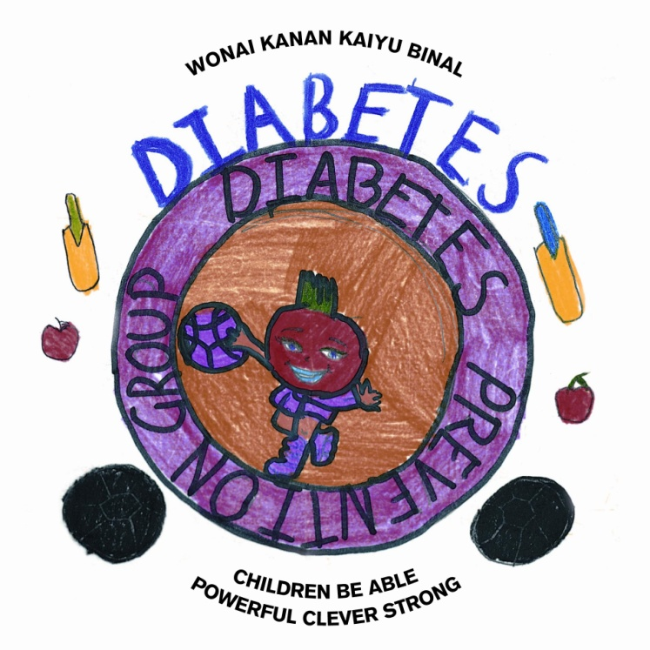
Acknowledgements
Children of Taree, Kempsey and Lower Hunter and their families.
Biripi, Durri and Awabakal ACMSs.
nturner@durri.org.au

