Slide 1
Māori Cultural Competency in Aotearoa / NZ
Indigenous Allied Health Australia Incorporated
National Conference November 2012

Slide 2
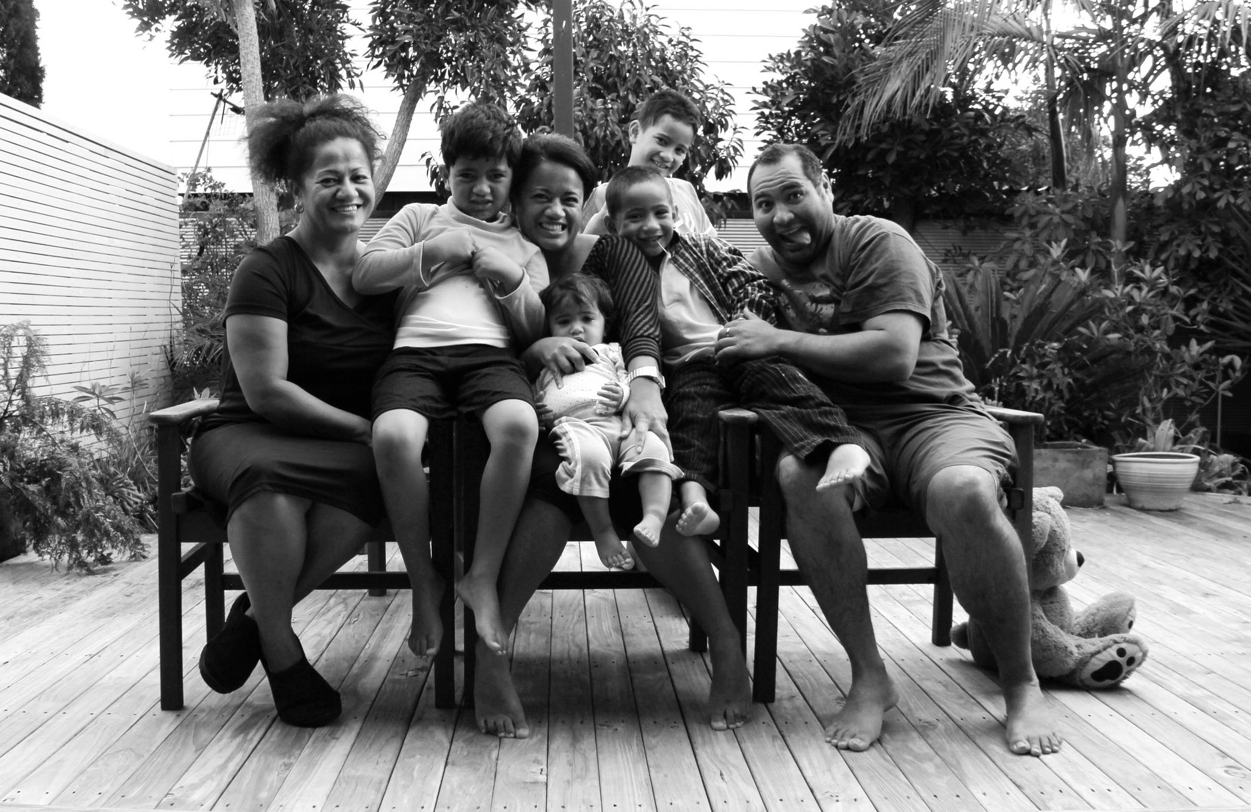
Vision – Kaupapa
© Mauriora Associates 2012
November 2012
2

Slide 3
Mission - Responsibility
To actively support the development of a clinically and culturally competent health workforce in Aotearoa/ New Zealand

Slide 4
Culture means…
For this presentation, ‘culture’ mean people who share a view of the world, language, customs, a pattern of beliefs and practices i.e. shared ethnicity

Slide 5
Cultural Competence - Why?
Because we work with culturally diverse populations?
Because health statistics show that some populations do well using our health services while others do not e.g. Māori
Because the contexts in which we work promote cultural incompetence
No common definition exists across registered authorities in New Zealand.
© Mauriora Associates 2012
November 2012
5

Slide 6
What’s in a name?
Cultural sensitivity/ awareness
Cross cultural – self analysis
Cultural safety – patient perception
Cultural competency –standards of practice
Cultural agility – relocatable
© Mauriora Associates 2012
November 2012
6

Slide 7
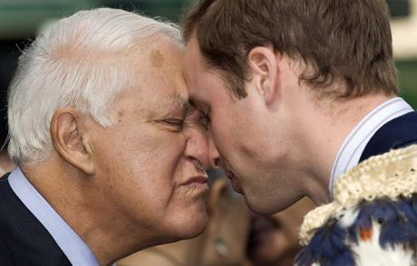
Partnership

Slide 8
Indigeneity
Māori are indigenous to Aotearoa
Māori + Crown + Treaty = Governance partners
Māori people retained sovereignty
The Treaty took account of the preservation and ownership of Māori land, sea, beliefs and treasures

Slide 9
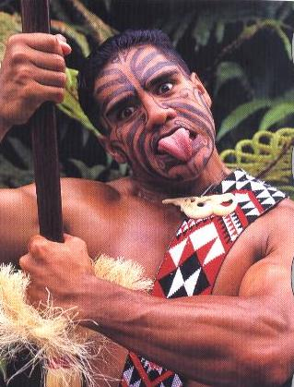
Taonga

Slide 10
Mauriora Associates
Capacity and Capability
  Māori-led health (kaupapa Maori)
  Kaupapa Maori research (evidence based)
  Company (independent)
  NZQA accredited private training establishment (PTE)
  Provide Cornerstone Training (NZGP’s)
  Committed Māori educationalists and clinicians
  Collaborate within health and across sectors
  Provide Māori leadership
  Advocate for at risk populations

Slide 11
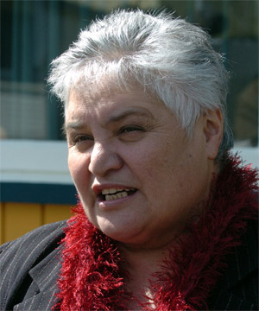
Culturally Competent
New Zealand
Health Practitioners
© Mauriora Associates 2012
November 2012
11

Slide 12
Health Practitioners Competence
Assurance Act 2003
The Health Practitioners Competence Assurance Act 2003 (the Act) is about public safety. Its purpose is to protect the health and safety of members of the public by providing mechanisms to ensure the life long competence of health practitioners.
A formal review of the HPCA Act 2003 commenced on August 31 2012. A discussion document has been published by the Ministry of Health seeking views from stakeholders. Closing date for submissions is October 26 2012.
© Mauriora Associates 2012
November 2012
12

Slide 13
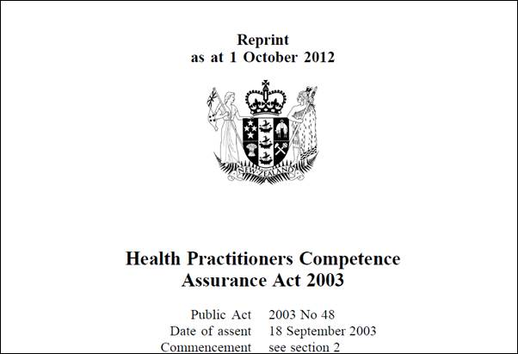
Health Practitioners
Competence Assurance Act 2003 S29
Decisions of authority as to practising certificate and scope of practise
‘The authority should not issue the certificate unless it is satisfied that the applicant meets the required standard of competence’
‘The authority may include new conditions in the applicants scope of practice..’
© Mauriora Associates 2012
November 2012
13

Slide 14
Health Practitioners
Competence Assurance Act 2003 S118
  (i) to set standards of clinical competence, cultural competency and ethical conduct to be observed by health practitioners of the profession
  to liaise with other authorities appointed under this Act about matters of common interest
  to promote education and training in the profession
  to promote public awareness of the responsibilities of the authority
  to exercise and perform any other functions, powers and duties that are conferred or imposed on it by or under this Act or any other enactment
© Mauriora Associates 2012
November 2012
14

Slide 15
NZ Registered Authorities
Dental Council www.dcnz.org.nz
Dietitians Board www.dietitiansboard.org.nz
Medical Laboratory Science Board www.mlsboard.org.nz
Medical Radiation Technologists Board www.mrtboard.org.nz
Medical Council ww.mcnz.org.nz
Midwifery Council www.midwiferycouncil.org.nz
Nursing Council www.nursingcouncil.org.nz
Occupational Therapy Board www.otboard.org.nz
Optometrists and Dispensing Opticians Board www.opticiansboard.org.nz
Osteopathic Council www.osteopathiccouncil.org.nz
Pharmacy Council www.pharmacycouncil.org.nz
Physiotherapy Board www.physioboard.org.nz
Podiatrists Board www.podiatristsboard.org.nz
Psychologists Board www.psychologistsboard.org.nz
Psychotherapists Board www.pbanz.org.nz
© Mauriora Associates 2012
November 2012
15

Slide 16
Non-regulated
Health Practitioners
Not all health professions are regulated under the Health Practitioners Competence Assurance Act (the Act) however that does not imply that a profession lacks professional standards.
All practitioners providing health or disability services are subject to the Code of Health and Disability Services Consumers’ Rights.
The Code has ten consumer rights.
© Mauriora Associates 2012
November 2012
16

Slide 17
Code of Health and Disability
Services
Right to be treated with respect
Right to freedom from discrimination, coercion, harassment and exploitation
Right to dignity and independence
Right to services of an appropriate standard
Right to effective communication
Right to be fully informed
Right to make an informed choice and give informed consent
Right to support
Rights in respect of teaching or research
Right to Complain
© Mauriora Associates 2012
November 2012
17

Slide 18
Challenges for Registration Authorities
Costs of developing appropriate courses, facilitating courses, time off work and travel.
Resources developed by some Registered Authorities and District Health Boards.
Some face-to-face workshops & online knowledge courses e.g. District Health Boards.
How do we evaluate effectiveness?

Slide 19
The cultural competency online training tool (CCTT)
© Mauriora Associates 2012
November 2012
19

Slide 20
DVD Trailer
Introduction Video
Mauriora Foundation Course in Cultural Competency Introduction Video
http://www.mauriora.co.nz/moodle/file.php/1/ccpreview3a.mp4
© Mauriora Associates 2012
November 2012
20
Notes:
Right click on the hyper link and click ‘open hyperlink’

Slide 21
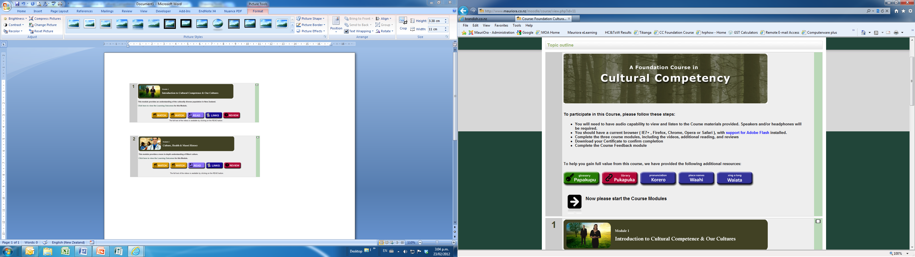
Introduction
Papakupu – glossary
Pukapuka – library
Korero – pronunciation
Waahi – place names
Waiata – song
© Mauriora Associates 2012
November 2012
21
Notes:
Login details for you are – username: riripeti and password: mickimouse (don’t for get to check the sound is on)
To Login to the DEMO - (don’t for get to check the sound is on)
Go to website www.mauriora.co.nz
Click on the ‘e-Learning’ tab
Click watch preview
For those who do not have logins click on “Login as a guest”
Then you will linked to the video
To Get the CC Video - (don’t for get to check the sound is on)
Go to website www.mauriora.co.nz
Click on the ‘Courses’ tab
Scroll down to ‘Foundation in Cultural Competency’
Click on the ‘Read More’ button
This will link you to more information and the video
Click on the ‘play’ button to watch the video

Slide 22
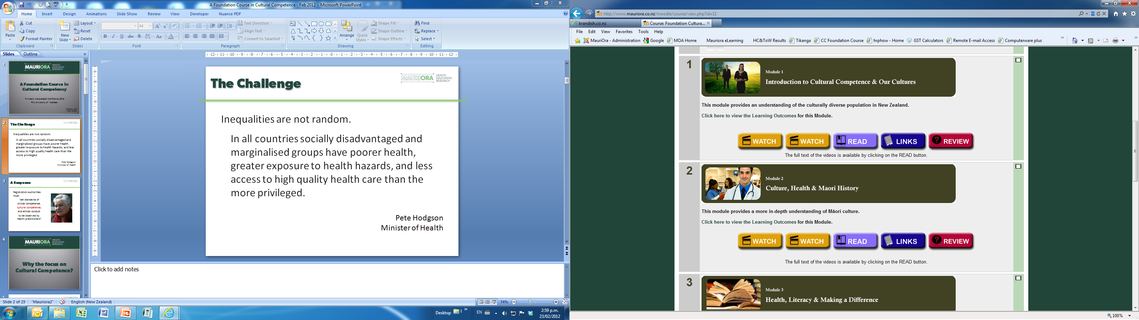
Module 1
Introduction to Cultural Competency and Our Culture
Legislation
Treaty of Waitangi
Health Practitioners Competence Assurance Act 2003
New Zealand Public Health and Disability Act
Health and Disability Commission Act 1994
© Mauriora Associates 2012
November 2012
22

Slide 23
Module 2
Culture Health & Māori History
Cultural Communities
New Zealand Cultures
Māori History
Māori Health Disparities
© Mauriora Associates 2012
November 2012
23

Slide 24
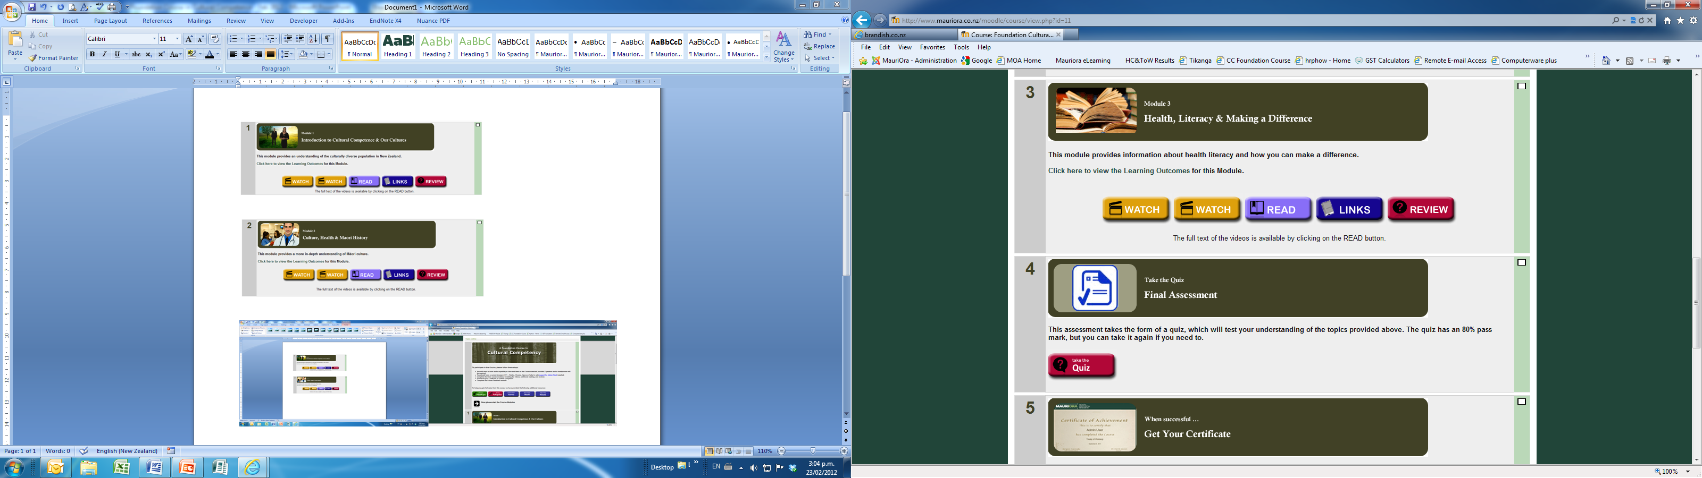
Module 3
Health Literacy & Making a Difference
Special Guest Video Presentation
Understanding medical advice and information
Making a difference/ call to action
© Mauriora Associates 2012
November 2012
24

Slide 25
Assessment
Key points are provided at the end of each module
Assessment is measured using randomised questions
Questions can prompt critical thinking not just information regurgitation
Develop innovative and creative ways to assess users
© Mauriora Associates 2012
November 2012
25

Slide 26
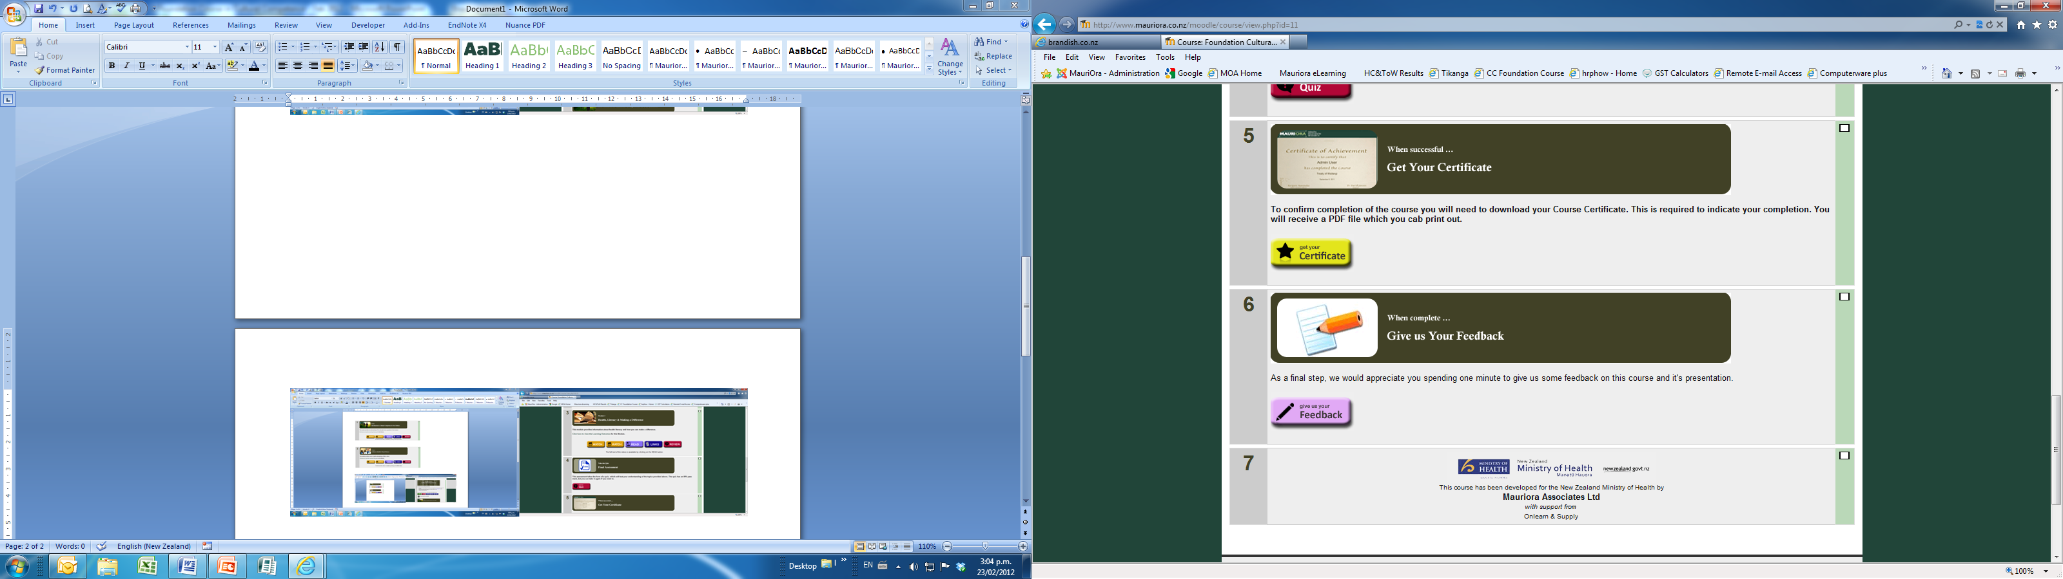
Certificate
Certificate can be branded and can be printed after successful completion
© Mauriora Associates 2012
November 2012
26

Slide 27
Feedback
Feedback informs continued improvement
Initially it was proposed that 48,000 users would access the CCTT training
© Mauriora Associates 2012
November 2012
27

Slide 28
Progressive/Categorical Training
Progressive learning approach
  (foundation, intermediate, advanced)
Categorical training
  Dietitians, Physiotherapists, General Practitioners
  Review learning approaches and teaching methodology
  Review RA Cultural Collateral/ Branding
  Undertake cultural audits (MCNZ)
  Support RA’s to develop cultural standards/ strategic goals
Online courses/ seminars

Slide 29
Successes
Supports the improvement of Māori health
Commissioned by the Ministry of Health
National/ sets benchmark
Foundational/ progressive learning
Affordable
Accessible/ information technology
Non threatening/ factual information
Supports compliance
© Mauriora Associates 2012
November 2012
29

Slide 30
User Feedback
Common responses:
  Accessible – at home.
  Concise and clear training.
  Able to complete quickly.
  Direct and simple training.
  Multi media approach.
  No cost.
  Good Resources.
  Ability to revisit site.
  Practical, not just theory.
User Suggestions:
  Develop next level.
  Voice intonation varied.
  Video access a problem.
  Too much lag time.
  Add link to registered authorities.
  Provide case studies.
  Use shorter questions.
  Course should be compulsory.

Slide 31
Registered & Non-registered
Health Workforce
© Mauriora Associates 2012
November 2012
31

Slide 32
Expected outcomes
Development of effective, trusting relationships between practitioner/patient
Greater disclosure from patients
Increased compliance with treatment
Better patient outcomes
Increase patient satisfaction
Potential to improve the efficiency & cost-effectiveness of health care
© Mauriora Associates 2012
November 2012
32

Slide 33
Key Points to Remember
Resistance varies across the continuum
Buy in is critical
Focus on cases – straight didactics are quickly forgotten
Assess demand for categorical approaches (tailor made)
Think longitudinal
There is no end point
Integrate (open to all/ fit in with group)
Sociocultural matters matter and impact on communication
There are strategies you can learn
Improves quality and effectiveness
© Mauriora Associates 2012
November 2012
33

Slide 34
International Collateral
Riripeti Haretuku
Mauriora Associates CEO

Slide 35
Content
Declaration of Independence
Te Tiriti o Waitangi
Current Child Health Profile
International Declarations
Indigenous Rights
Human Acts
Conclusion
© Mauriora Associates 2012
November 2012
35

Slide 36
1835 Declaration of Independance
The handwritten Declaration, consisting four articles, asserted the independence of Nu Tirene (New Zealand) under the rule of the ‘United Tribes of New Zealand’.
Māori had no say in the preparation of this document. By 1839, 52 chiefs had signed the declaration, which was acknowledged by the British government.
It remains a significant mark of Māori national identity.
© Mauriora Associates 2012
November 2012
36

Slide 37
1840 Te Tiriti o Waitangi/
The Treaty of Waitangi
The Treaty is a political compact between tribal leaders of Māori hapū and the British Crown and set the foundation for the establishment of the British government in New Zealand.
There is a Māori and English version of the treaty which consists of four articles.
The interpretation of the Treaty by Māori and the Crown remains a constant tension in New Zealand between the Crown and Māori.
© Mauriora Associates 2012
November 2012
37

Slide 38
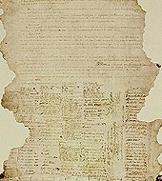
Te Tiriti o Waitangi
Parties
Philosophical differences
Practices
Parameters
Partnership
Protection
Preservation
Problems arose
Passive redress
Promises
Power shift
Power reasserted
© Mauriora Associates 2012
November 2012
38
Notes:
Customs, beliefs and practices

Slide 39
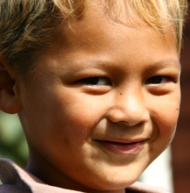
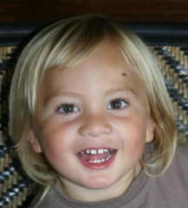
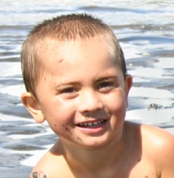
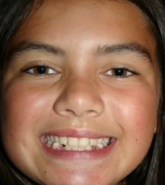
Māori child health profile 2000
Māori children are more likely to:
die as a result of injuries, poisonings, road traffic injuries, SIDS, respiratory conditions, and infectious diseases – all potentially preventable health conditions.
be admitted to hospital in the first 5 years of life.
be hospitalised for respiratory conditions, injuries and poisoning, and nervous system diseases.
drop out of school, be truant, leave school early
be over-represented in the disability statistics.
be born into social and economic circumstances that exacerbate illness.
go to juvenile court
© Mauriora Associates 2012
November 2012
39

Slide 40
Māori whānau profile 2012
Violence in homes
Violent crime
Women criminals
Child abuse and maltreatment
Murder
Domestic violence
Suicide (15-19 yr)
© Mauriora Associates 2012
November 2012
40

Slide 41
Indigenous Rights
Collective experience
Colonisation/ Collaboration
Confiscation of land and erosion of culture
Crowns responsibility to protect
Children - future
“indigenous children .. are the custodians of a multitude of cultures, languages, beliefs and knowledge systems, each of which is a precious element of our collective heritage”
(UNICEF, 2004)
© Mauriora Associates 2012
November 2012
41

Slide 42
The Universal Declaration of
Human Rights (1948)
All Humans are:
Born free, equal and without discrimination
Entitled to life, liberty and security
Not to be subjected to cruelty, inhuman or degrading treatment or punishment
Worship however they choose
Able to access health, education and services that provide adequate standards of living
Entitled to be protected from harm of any kind
Entitled to choose their culture
Entitled to exercise rights and freedoms which allow them to develop to their full capacity
© Mauriora Associates 2012
November 2012
42

Slide 43
Human Rights
Access to healthcare
Access to hospitals
Safe drinking water
Sanitation
Safe food
Adequate nutrition
Adequate housing
Healthy working and living conditions
Health related education and information
Gender equality
The right to health–is a fundamental Human Right and our understanding of a life of dignity.
© Mauriora Associates 2012
November 2012
43

Slide 44
UN Convention Rights of the Child
Article 30
In those States in which ethnic, religious or linguistic minorities or persons of indigenous origin exist, a child belonging to such a minority or who is indigenous shall not be denied the right, in community with other members of his or her group, to enjoy his or her own culture, to profess and practise his or her own religion, or to use his or her own language.
© Mauriora Associates 2012
November 2012
44

Slide 45
Māori Child Rights
A system for health protection
The right to prevention, treatment and control of diseases
Access to essential medicines
Maternal, child and reproductive health
Provision of education and information
Participation in health related decision-making
© Mauriora Associates 2012
November 2012
45

Slide 46
Key points to consider
Does Integrity lie in the intention (rhetoric)
“Abstract talk of Human Rights is meaningless if the humanity of people is not recognised” (M Jackson, 2004)
Broad principles (measurable)
Do these conventiones, treatise, declarations, intersect nationally and internationally to add more weight to compliance or do they undermine
Whaty is the consequence of non compliance
Equity and social justice
© Mauriora Associates 2012
November 2012
46

Slide 47
Does cultural competence address health professional bias
Prejudice
  Assumptions about the abilities, motives and intentions of others according to their ethnicity.
  There is good evidence that this applies in NZ, e.g. stereotypes about Māori: late presentation, non-compliance and treatment preferences.
Discrimination
  Differential actions toward others according to their ethnicity.
Jones, 2000
McCreanor and Nairn, 2002
Jones, 2000
McCreanor and Nairn, 2002
© Mauriora Associates 2012
November 2012
47

Slide 48
Stereotyping
Affects thinking and actions at an unconscious level, even among well-meaning, well-educated people who are not overtly biased
When does it tend to occur?
  In situations characterised by time pressure, resource constraints, and high cognitive demand
  This occurs due to the need for cognitive ‘shortcuts’ and lack of full information
© Mauriora Associates 2012
November 2012
48

Slide 49
Inequalities are not random
In all countries socially disadvantaged and marginalised groups have poorer health, greater exposure to health hazards, and less access to high quality health care than the more privileged.
Pete Hodgson
Minister of Health
© Mauriora Associates 2012
November 2012
49

Slide 50
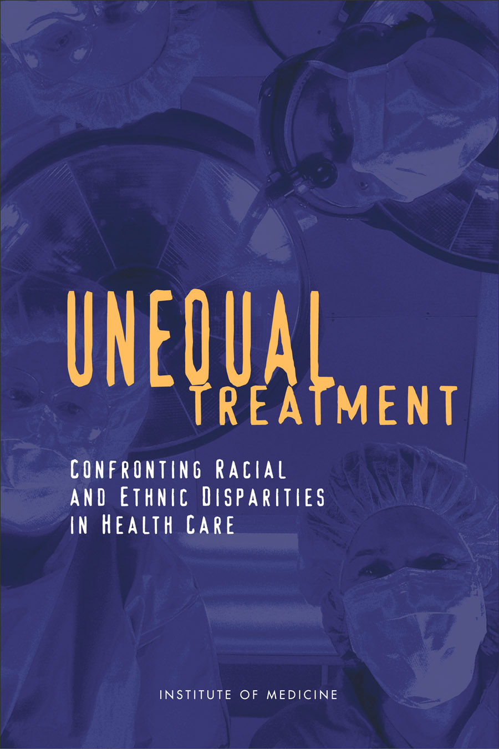
Evidence
Disparities are consistently found across a wide range of disease areas, clinical settings and services.
Joseph Betancourt
© Mauriora Associates 2012
November 2012
50
Notes:
Betancourt

