Slide 1
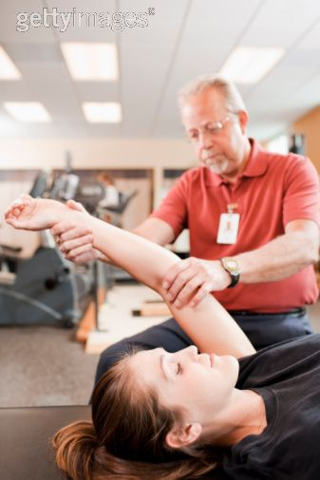
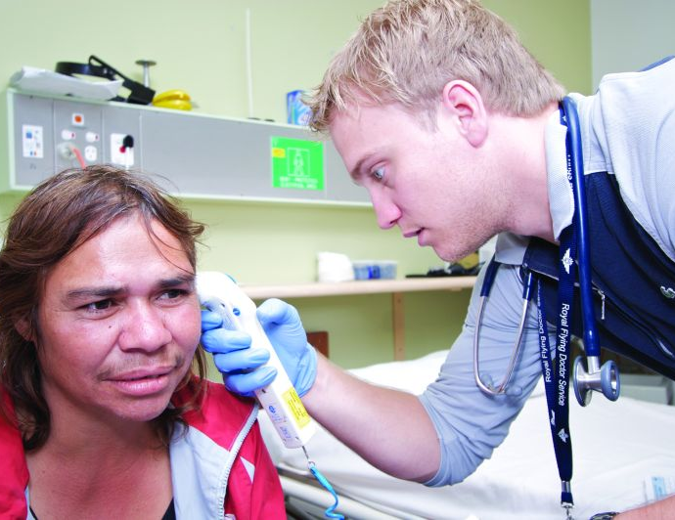
Services for Australian Rural and Remote Allied Health (SARRAH)

Slide 2
Overview
Who we are
What we do
Who are our members
Allied health scholarship schemes
High impact strategies for action
Questions

Slide 3
Who We Are
Nationally recognised as a peak body representing rural and remote allied health professionals (AHPs).
Established in 1995 as a ‘grassroots’ organisation, able to address the very particular needs of the individual rural and remote AHP.
Recognises rural and remote Australia as a continuum of communities outside of major metropolitan centres.
Committed to providing support for AHPs in all sectors.
Advocates for rural and remote AHPs, AHP practices and AHP students on local, state and national levels.

Slide 4
What we do
Inform and influence by contributing “our” perspective to policy and planning processes that govern health service delivery to rural and remote Australian communities.
Administer 5 allied health streams, approximately 900 scholars, under the Commonwealth Governments Nursing and Allied Health Scholarship Support Scheme.
Receive and administer, as one of six key organisations, Government funding under the Rural and Remote Health Stakeholder Support Scheme.

Slide 5
Who Are Our Members
SARRAH’s membership base comes from a range of allied health professions and students including but not restricted to:
Audiology - Osteopathy
Dental & Oral Health - Paramedic Practice
Dietetics & Nutrition - Pharmacy
Diabetes Education - Physiotherapy
Exercise Physiology - Podiatry
Medical Radiation Science - Prosthetics & Orthotics
Occupational Therapy - Psychology
Optometry - Social Work
Orthoptics - Speech Pathology.

Slide 6
Allied Health Scholarship Schemes
Clinical Placement – up to $11,000 for students studying an undergraduate or entry level course to experience a short term work placement in a rural or remote setting.
Clinical Psychology – up to $30,000 for a qualified generalist psychologists to obtain endorsement as a clinical psychologist.
Continuing Professional Development – up to $3,000 for practitioners to undertake short courses or attend conferences.
Post Graduate – up to $15,000 per annum for practitioners to undertake postgraduate study.
Undergraduate (entry level) – a minimum of $10,000 per annum for students to study an eligible allied or oral health course at University.

Slide 7
High Impact Strategies for Action
Overarching principles
Ecologically sustainable communities
Health gaps and workforce shortages in rural and remote Australia
Rural proof all policies.

Slide 8
High Impact Strategies for Action
High impact strategies
Appoint a Chief Allied Health Officer
Establish a national rural health policy underpinned by a rural and remote health plan
Develop an allied health evidence database to inform strategies for workforce development and reform.
Implement greater equity in allied health workforce support initiatives such as scholarship schemes, education and training programs, national rural mentorship program.

Slide 9
Questions?
Website: http://www.sarrah.org.au
Email: rod@sarrah.org.au
Tel: 02 6285 4960

